Slide 1



LUMINOSITY, BEAM AND BACKGROUND CONTROL SYSTEM RMS-R3 in the LHCb EXPERIMENT
S. Chernyshenko, V. Pugatch, D. Ramazanov, V. Kyva, O. Okhrimenko, V. Dobishuk
Institute for Nuclear Research of the National Academy of Sciences of Ukraine (KINR)
HEP-TEC 2025
“High Energy Physics. Theoretical and Experimental Challenges”
Kyiv, Jan 21-22, 2025

Slide 2
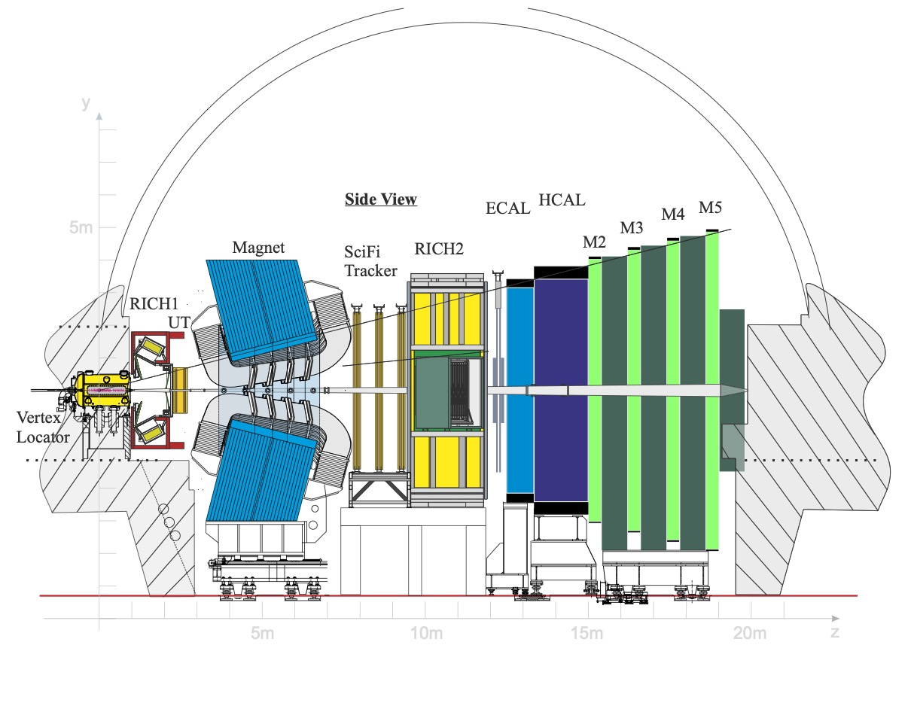
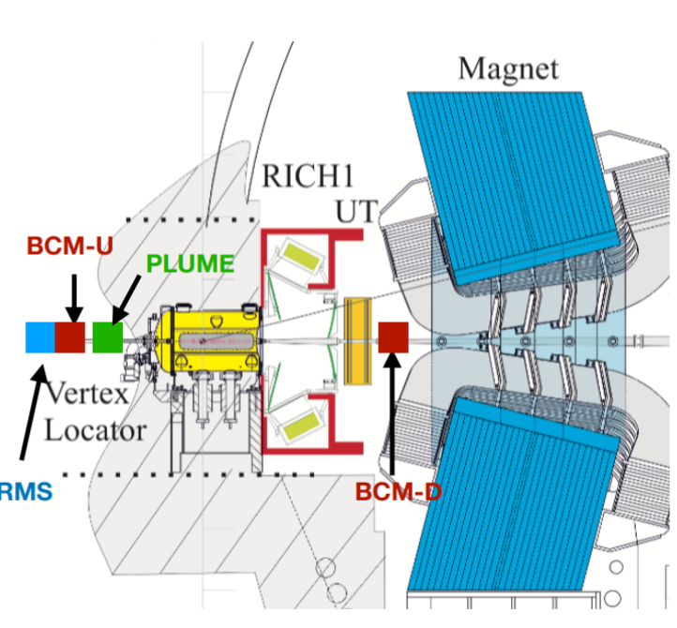
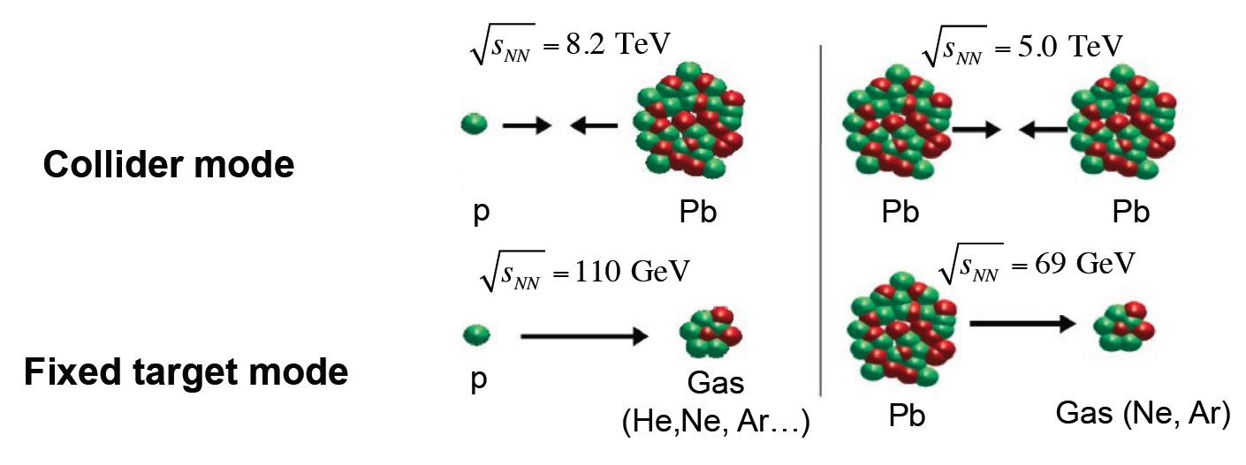
LHCb experiment
Nominal conditions in Run 3 (2022 - 2025):
P-p collision energy √s_{NN} = 13,6 TeV
Increased instantaneous luminosity up to 2x10³³ сm⁻²s⁻¹
Collider mode of operation and fixed (gas) target mode
LHCb research program
Flavor physics, in particular the physics of c- and b-quarks;
CP parity violation in B and D meson decays
Decays with flavor violation in the lepton sector
Physics beyond the flavor sector (Electroweak, exotic decays, QCD, etc.)
Search for New Physics beyond the Standard Model

Slide 3
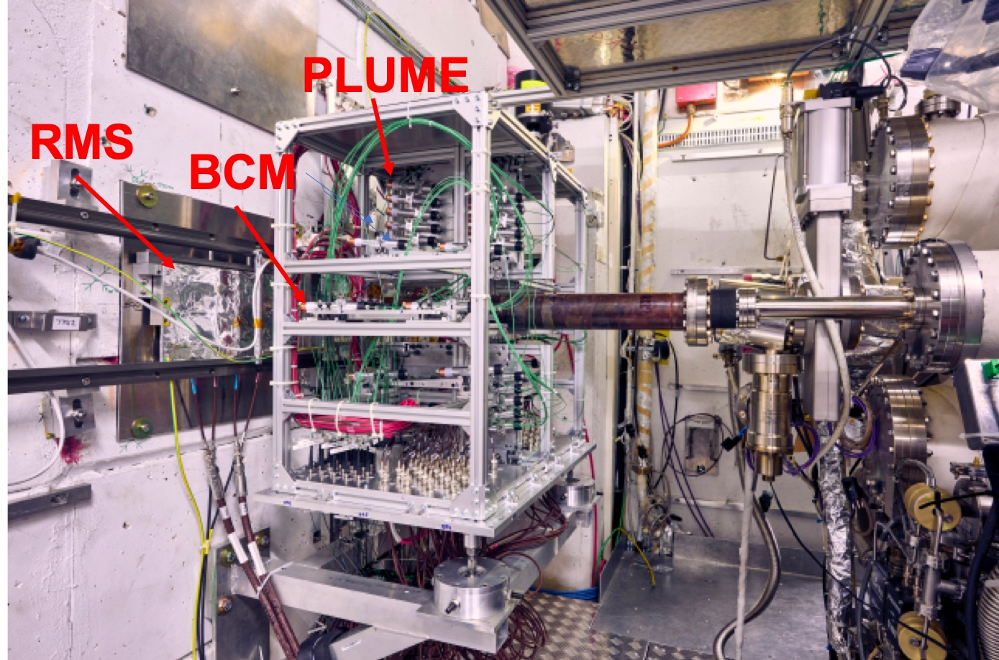
Beam and background monitoring systems
Beampipe
Beam and background monitoring systems (B&B) were created to ensure safe and efficient experimentation:
PLUME luminometer
Beam condition monitoring system (BCM)
Luminosity and background monitoring system RMS-R3
Luminosity and background beam conditions monitoring is essential to optimize collisions, reduce systematic uncertainties, and ensure safe detector operation by quickly detecting anomalous beam conditions that could harm the experiment.
Beam and background monitoring systems .
Taken from LHCb collaboration. LHCb Upgrade I

Slide 4
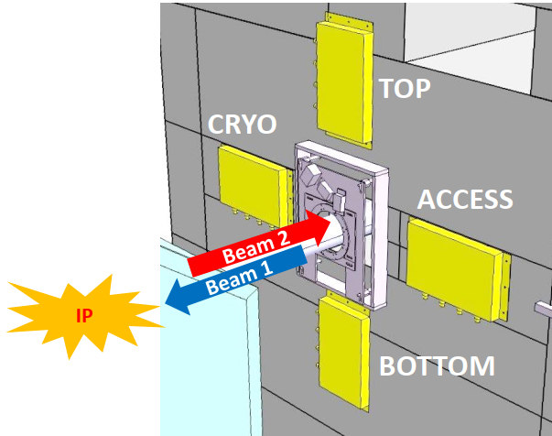
RMS-R3 as the B&B system monitor at LHCb
Goals:
• Instantaneous luminosity monitoring:
Nominal - 4×10³² cm⁻²∙s⁻¹ -> linear up to 2×10³³ cm⁻²∙s⁻¹
• Beams (Target) interaction region and background
conditions monitoring
• Construction:
Metal Foil Detectors → 4 pairs symmetrically in horizontal
and vertical plane around the beam pipe
• Reading:
• charge integrators, frequency counters
• LHCb Front-End board
• Data monitoring:
• Continuous display on the LHCb control panel
• Remote access to data through the LHCb framework
Key features:
• Radiation hard (~1 GGy) MFD sensors respond to
MIPs flux by secondary electron emission
→ positive charge in a Foil isintegrated
• charge-to-frequency conversion, - digital output
• Large dynamic range (10³-10⁹ MIPs/s → linear
response up to 2 MHz
• Stable response → ~ 1 % during Run 3
• Low operational voltage (24 V)

Slide 5
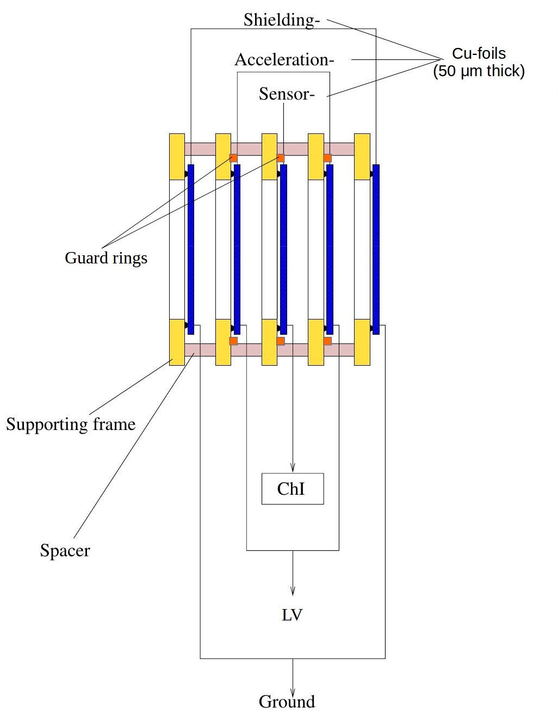
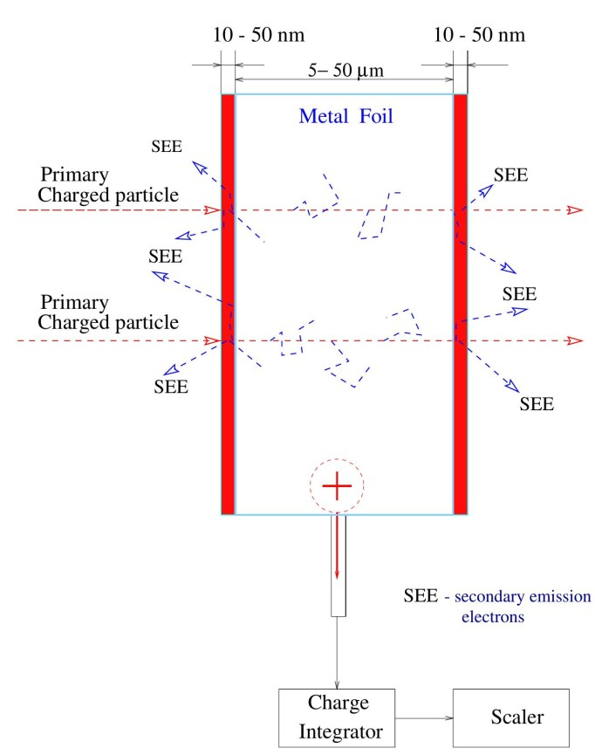
Beam and background system RMS-R3
The RMS-R3 is based on the metal foil detector (MFD) technology, an original development of the Institute for Nuclear Research of the National Academy of Sciences of Ukraine.
Fluxes of bombarding charged particles cause secondary electron emission (SE) from the near-surface layer of the sensor metal foil (10-50 nm)
The positive charge arising in the insulated metal foil (sensor) is integrated by a sensitive charge integrator
The input analog signal is converted proportionally by the charge integrator to the output frequency, which is measured by frequency counters based on STM32F4-Discovery microcontroller boards
RMS-R3 sensor schematic
Schematic of the physical phenomenon of EEE on the surface of foil sensors

Slide 6
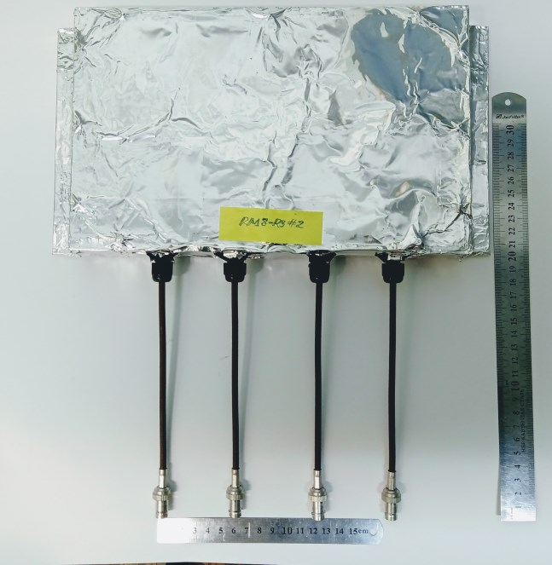
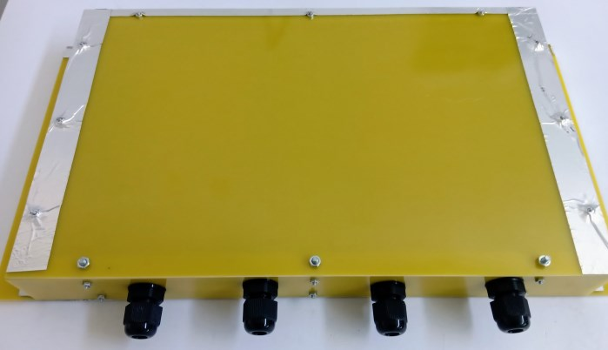
Design of the RMS-R3 touch module
The module contains 2 sensors 9×9 сm²
5 panels made of printed circuit board (PCB)
Sensors: copper foils 50 microns
Special protective rings for sensors (guard ring technology)
Protective input RC low-pass filters (resistance 1 MΩ, two capacitors 1 µF and 10 pF)
The module body, made of fiberglass, is covered with aluminum foil and grounded
Straight cable connector, BNC type

Slide 7
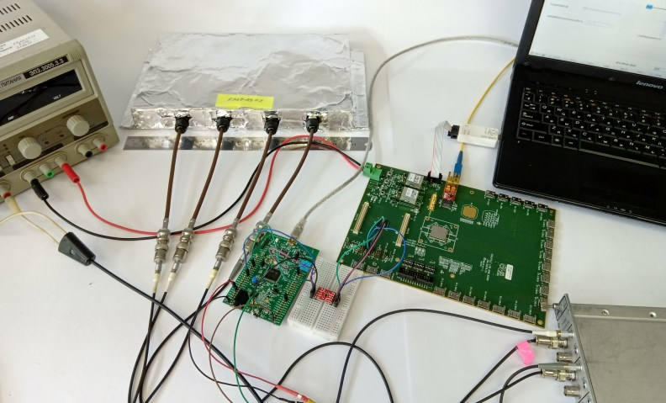
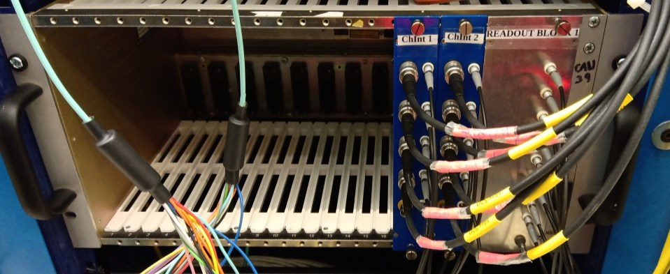
RMS-R3: electronics
Sensitive charge integrators
Universal ADC, developed by the SNR NASU
Charge-frequency conversion: the input current is converted into a sequence of output pulses with a proportional frequency
Sensitivity : 10 fА - 1 Hz
Input current range : 10 fА - 20 nА
Excellent linearity : ± 0,02% at 2 MHz
Radiation resistance : ~ 3 kRad
Frequency counters
Based on the STM32F4DISCOVERY development board (developed by STMicroelectronics)
Two 32-bit programmable timers (counters)
I2C interface for communication with the VLDB board
Universal communication board VLDB
Versatile Link Demonstrator Board (VLDB) (Developed by the group CERN ESE)
Board for operation in a radiation-resistant optical communication ecosystem
4,8 Gbit/s, data transition b/w FE and BE
Radiation resistance up to 400 Mrad
Модуль RMS-R3
VLDB
STM32F4
Блок ЗІ
R. Lesma et al., JINST 12 C02020 (2017)

Slide 8
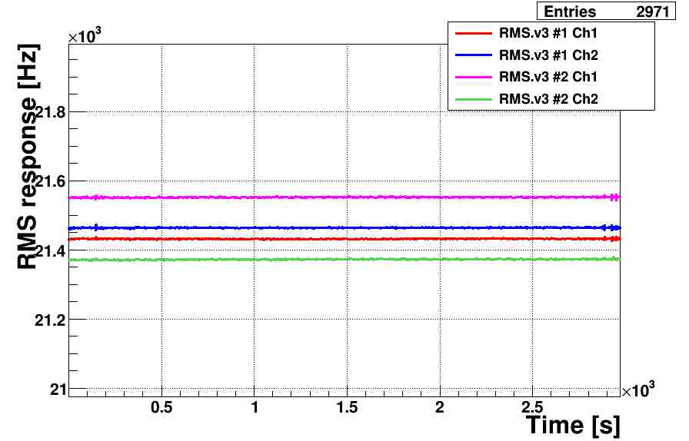
RMS-R3 response to calibrated current (baselines)
Control measurements were carried out for 21 days
Sensitive charge integrators were used (1 Hz corresponds to 1 fA)
The LHCb experiment uses charge integrators with the following parameters:1 Hz corresponds to 10 fA
Projections of RMS-R3 baselines in the LHCb experiment. RMS deviation from 7.5 Hz to 10 Hz -> high stability, noise < 0.1%
Відгук сенсорів RMS-R3 при вимірюванні базових ліній

Slide 9
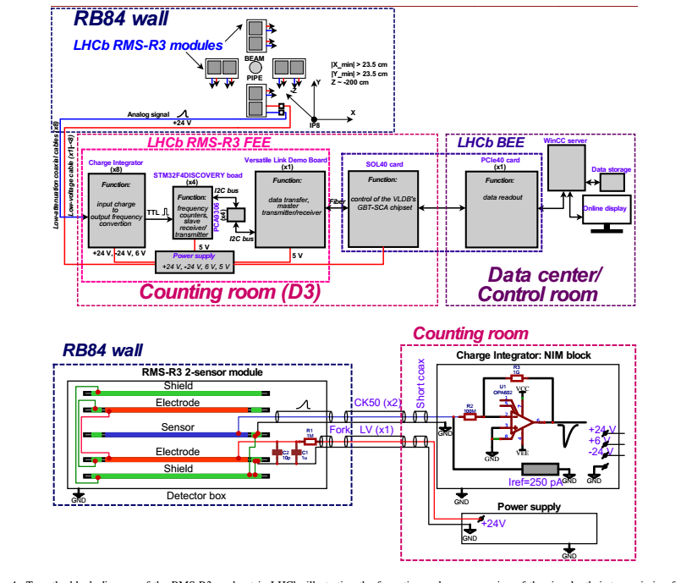
RMS-R3 functional structure and features for Beam and Background Monitoring at LHCb
Precision geometry layout
around the beam pipe at 2.2 m from IP8:
4 pairs of the MFD detectors
Top-Bottom and Left-Right pairs of detectors measure asymmetries of their response to particle fluxes
Any change of asymmetries – on-line indication and message to the shift crue about the change of the conditions of the experiment
Perfect measurement of luminosity:
pp collisions at 2×10³³ sm⁻² a⁻¹ (linear up to 10 times higher)
PbPb collisions from 10²⁸ sm⁻² s⁻¹

Slide 10
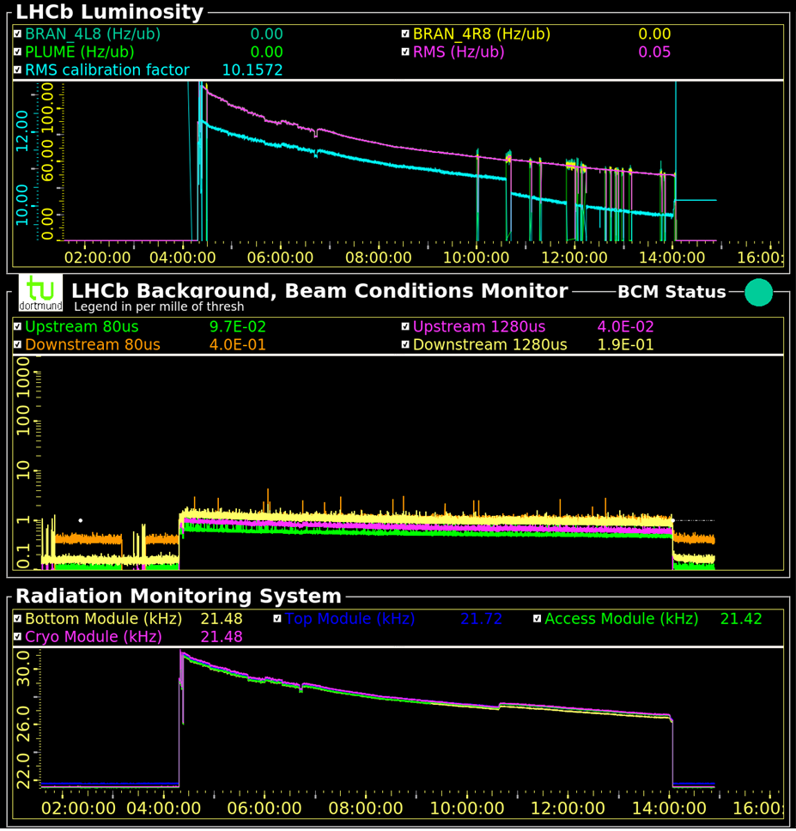
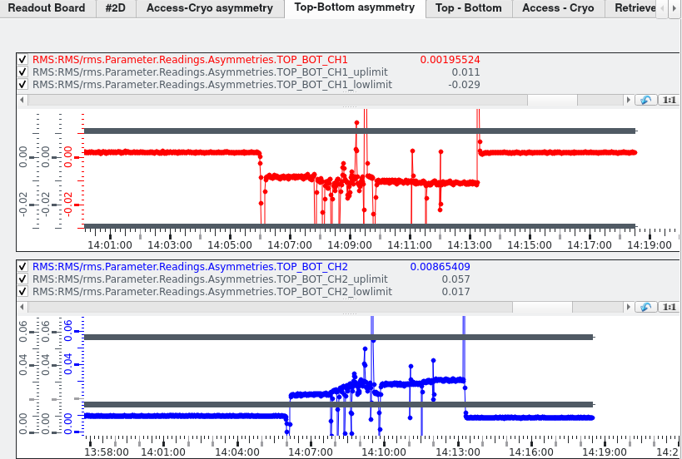
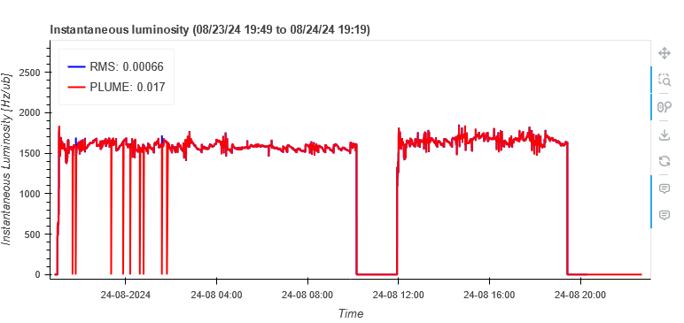
RMS-R3 data on the beam and background monitoring panel

Slide 11
RMS-R3 as an additional luminosity counter
Currently, LHCb provides instantaneous luminosity for LHC -> beams are adjusted -> target luminosity is being reached
PLUME is the main luminosity counter
RMS-R3 - backup luminosity counter
RMS-R3 used as a backup online luminosity meter

Slide 12
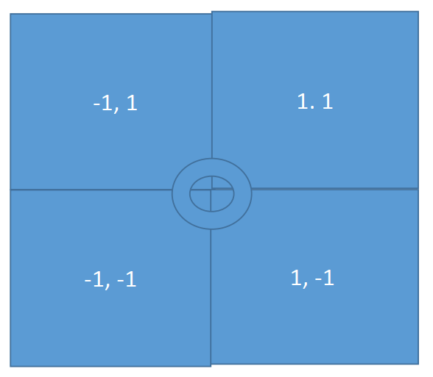
Theory of asymmetries method
А_{ij} = (R_{i} – R_{j} ) / (R_{i} + R_{j} ),
where Ri and Rj are the response frequencies of sensors i and j corresponding to the LEFT - RIGHT or UP - DOWN pairs
Full cross section
azimuth angle aperture
polar angle aperture
angles of RMS-R3 modules acceptance
The response of the RMS-R3 sensors depends directly on where the interaction occurred
4/15

Slide 13
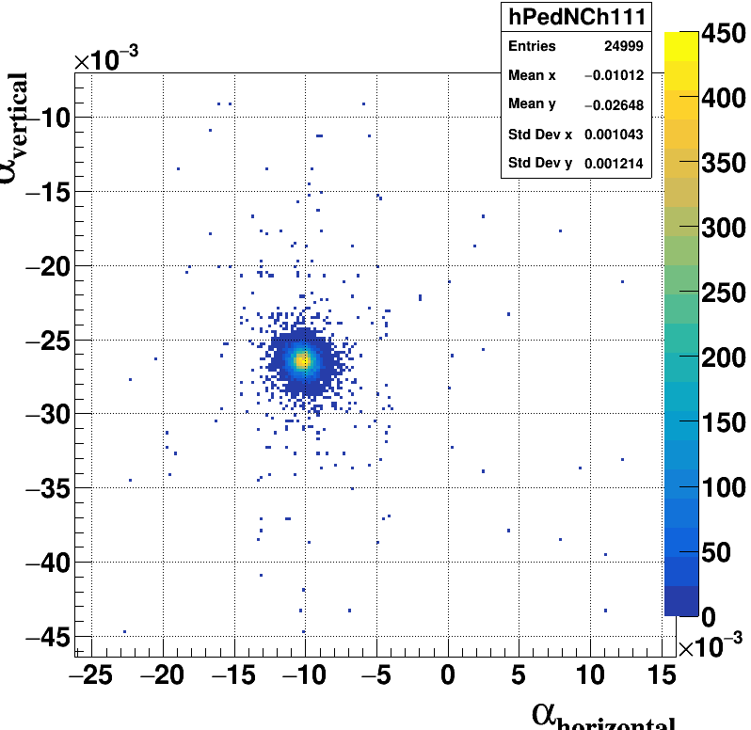
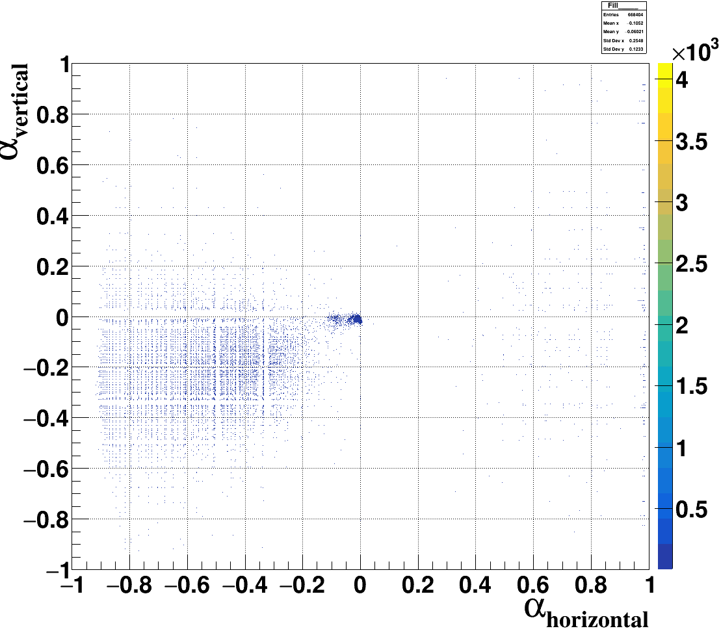
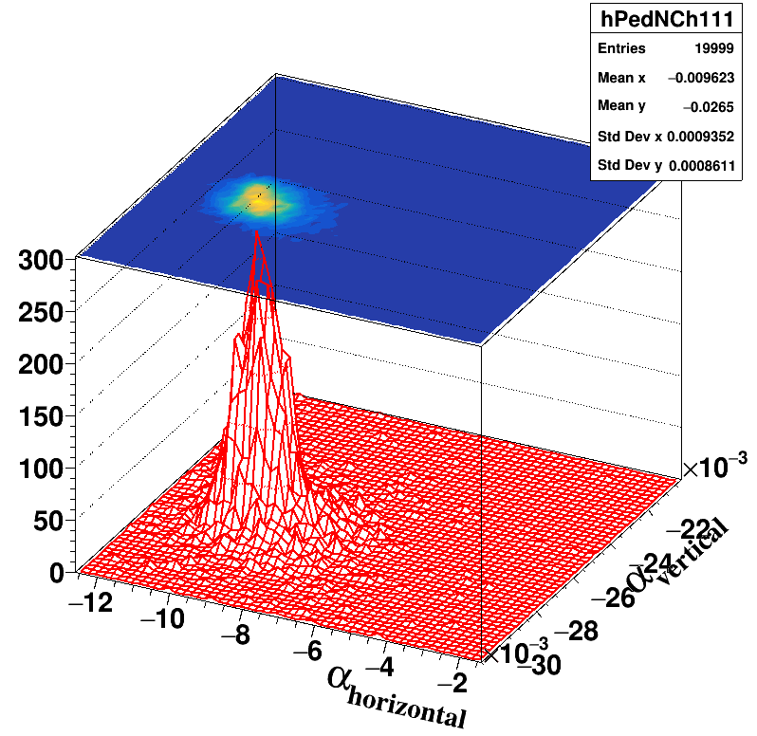
Scale of asymmetries in the response of RMS-R3 sensors
The value of the RMS-R3 asymmetry scale in the illustrations presented here is increased by a factor of 1000. That is, on the plane of asymmetries from -1 to 1, the “diameters” of the loci are ~ 5-20 * 10⁻³ .
Asymmetries for proton-proton collisions under normal conditions of the experiment (stable beams)

Slide 14
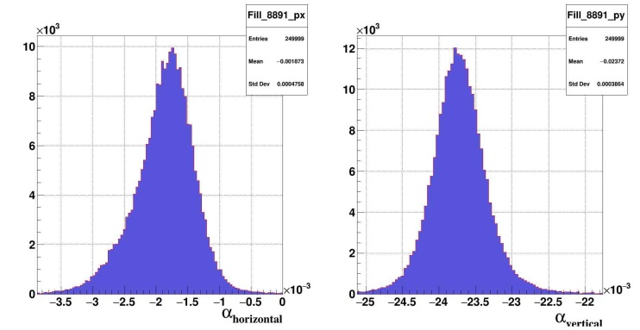
RMS-R3 asymmetries for different experimental conditions
pp collisions
PbPb collisions
PbPb + PbAr collisions
RMS-R3 asymmetry is
А_{ij} = (R_{i} – R_{j} ) / (R_{i} + R_{j} ),
where R_{x} is sensor response
The 2D distribution of asymmetries is sensitive to the changing of the beam and background experimental conditions.
The functional purpose of the RMS-R5 is to monitor the state of the beam and background, and to control LHCb radiation safety
pp collisions for √s_{NN} = 13,6 TeV for luminosity 2×10³³ sm⁻² a⁻¹
PbPb collisions for √s_{NN} = 5,36 TeV for luminosity up to 10²⁸ sm⁻² s⁻¹
Entries
pp collisions
PbPb collisions
Top-Bottom Asymmetry
Access-Cryo Asymmetry
03.10.23 | Fill 9220
Ar injection a la SMOG Locus coordinates (-4*10⁻³; -30*10⁻³)
Sigma ~ 9,3*10⁻³
09.06.23 | Fill 8891 | µ ≈ 4
Locus coordinates (-2*10⁻³; -2*10⁻³)
Sigma ~ 0.43*10⁻³
28.09.23 | Fill 9200
Locus coordinates (-21 *10⁻³; -30*10⁻³)
Sigma ~ 14,4*10⁻³

Slide 15
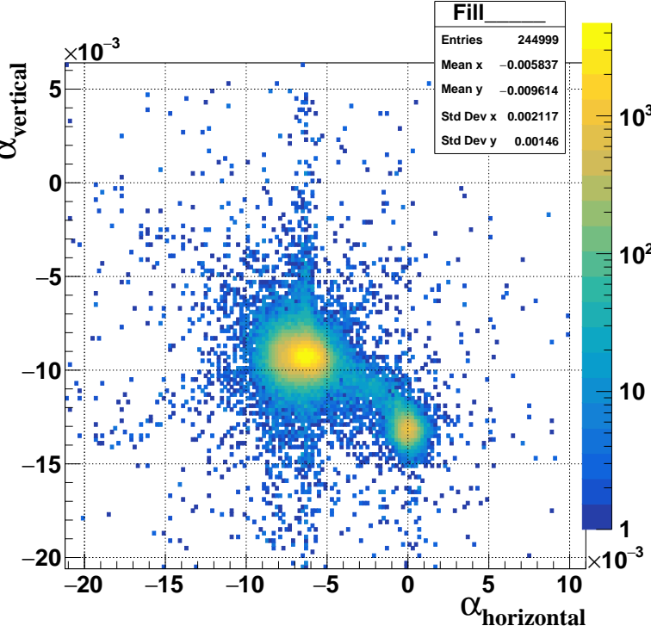
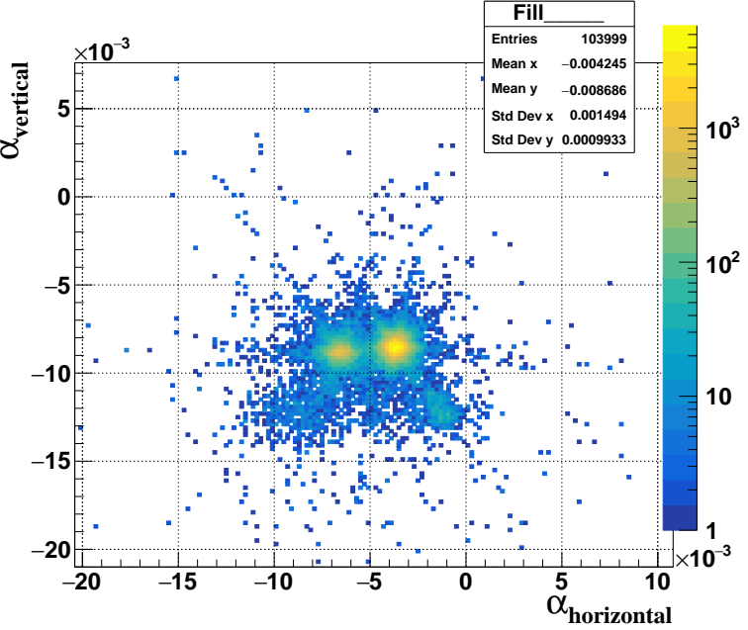
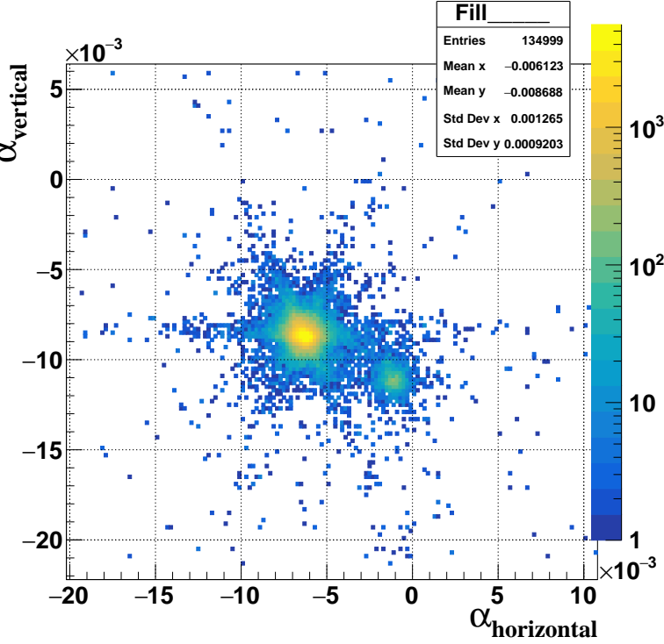
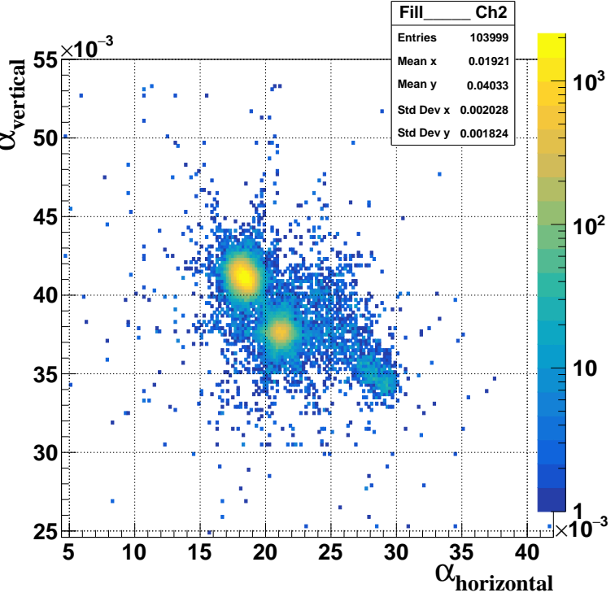
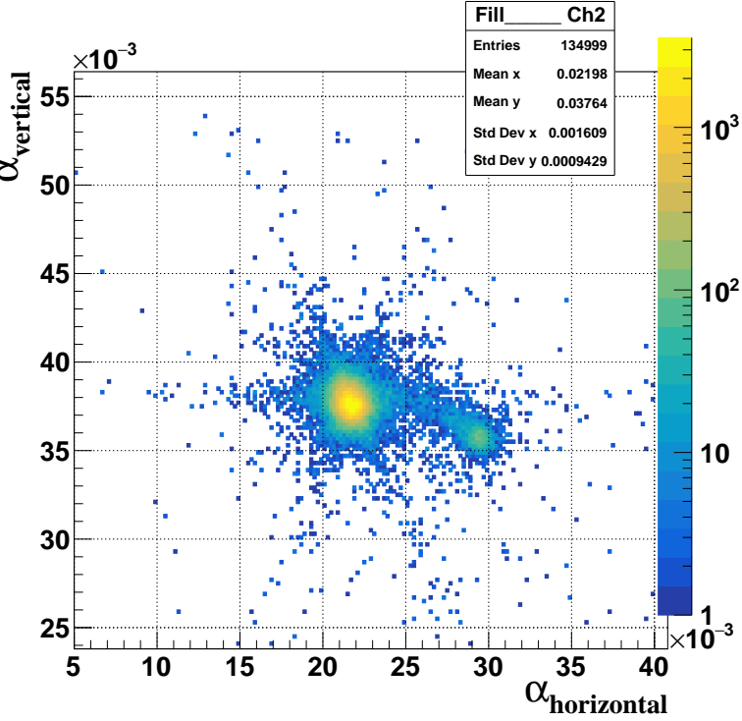
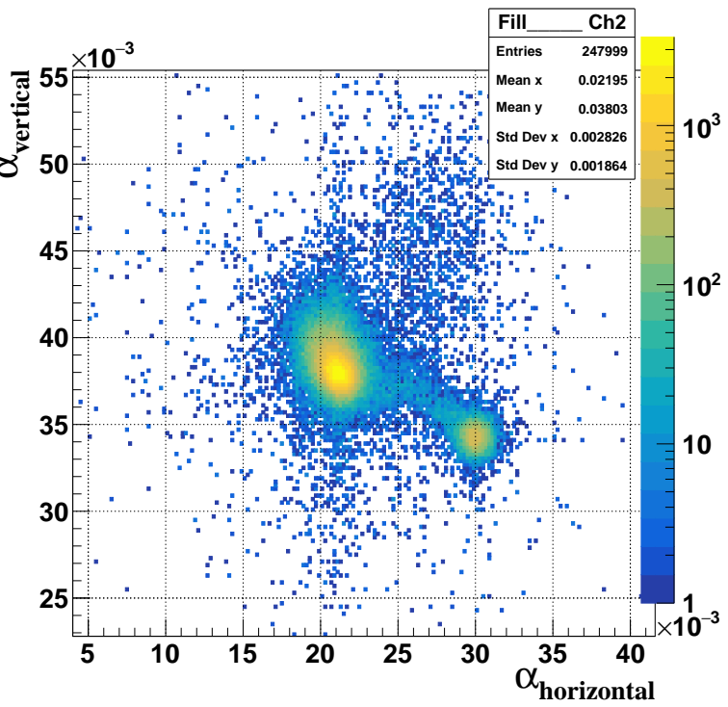
Asymmetries of pA for injections of different gases in the fixed target mode in 2024
H2 He Ne
Ch1
Ch2

Slide 16
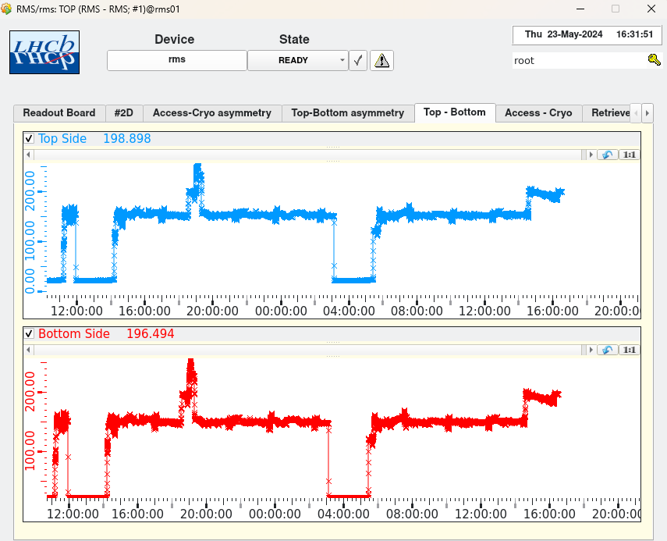
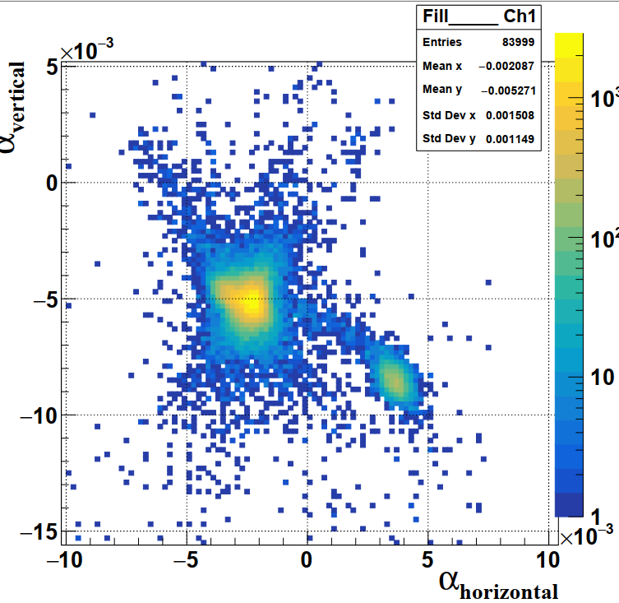
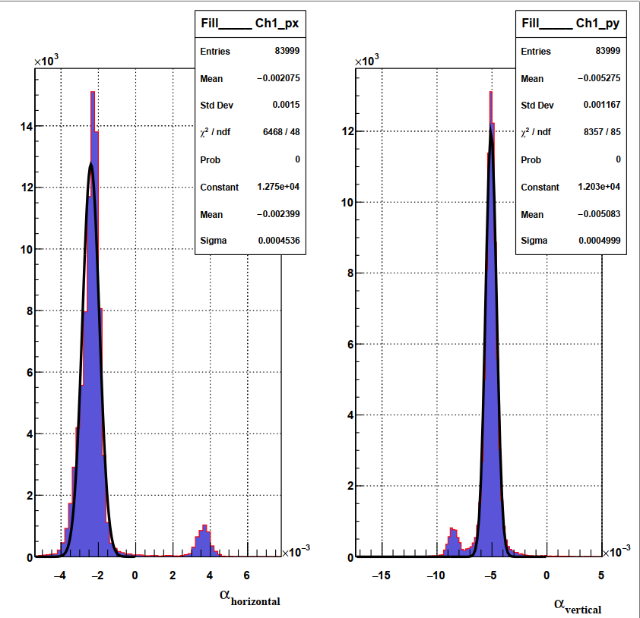
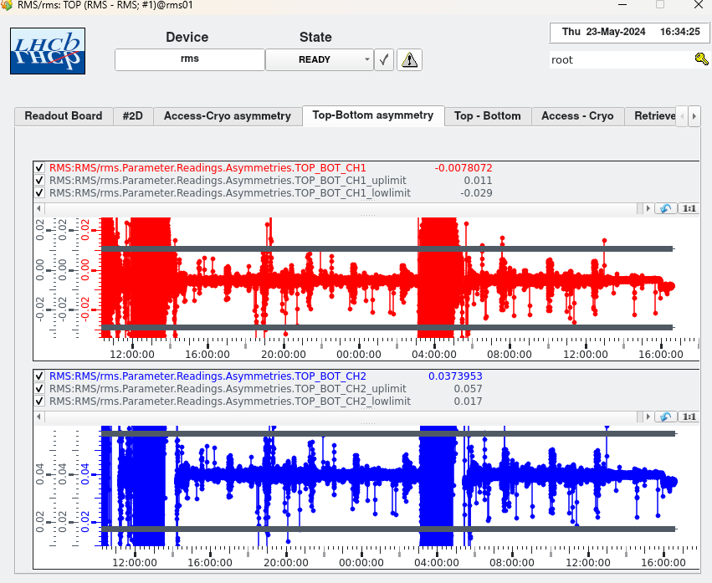
Displaying asymmetries. WinCC software package
Standard deviation for the horizontal component of the asymmetries ~ 4.5 * 10⁻⁴ units, for the vertical component of the asymmetries ~ 5 * 10⁻⁴ units

Slide 17
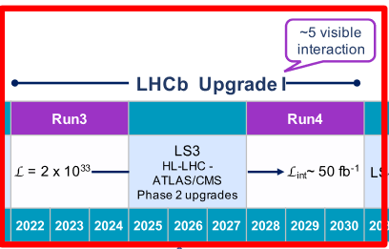
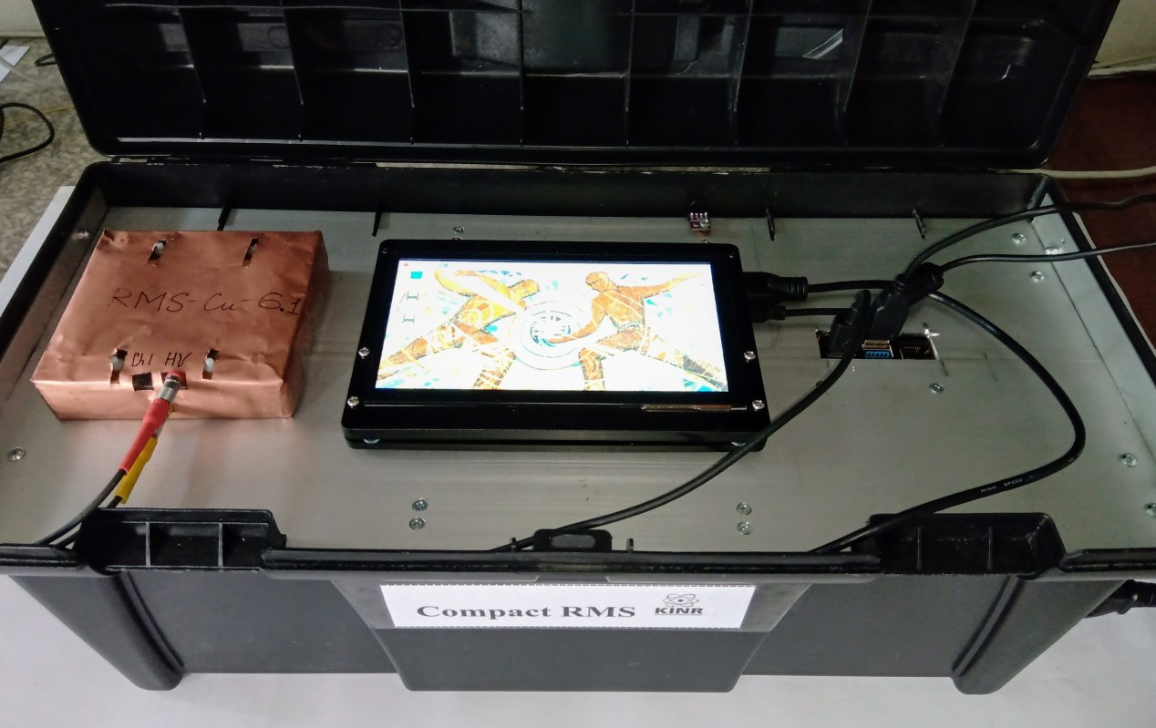
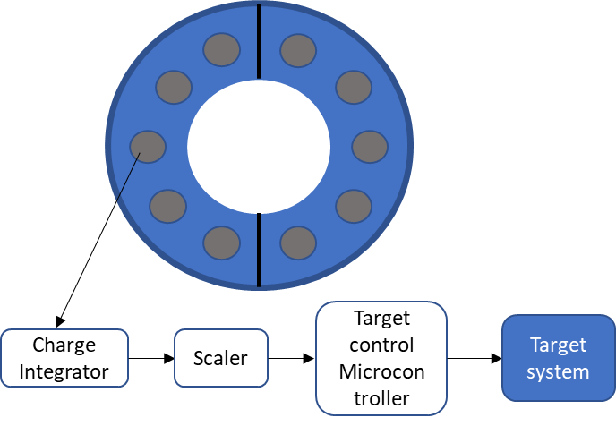
RMS-R3. Prospects.
RUN4 will start in 2028, Run5 in 2033 -> New luminance and background system RMS-R4 and RMS-R5
Development of a mobile system for monitoring and displaying in real time the radiation situation in the environment and for radiation therapy, based on Compact RMS with the use of additional silicon sensors, pressure, temperature, and humidity sensors.
Development of a system for controlling luminance and background in the CBM experiment (GSI, FAIR) - MS-CBM-R1.

Slide 18
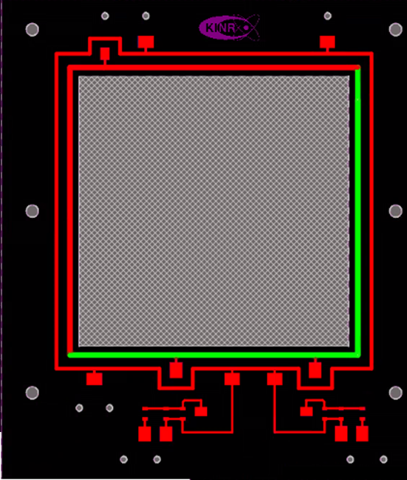
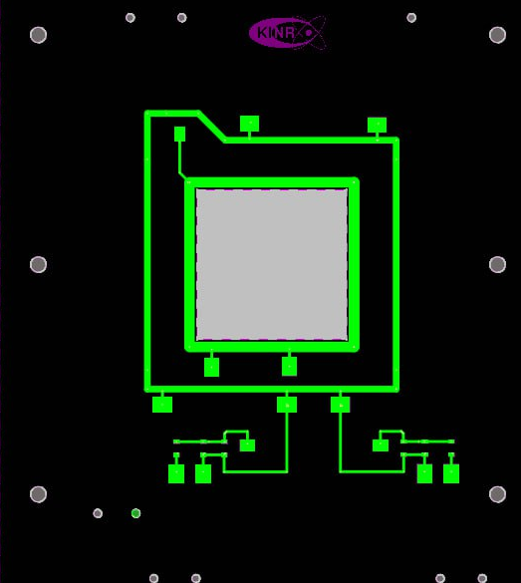
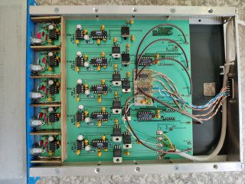
Rms-R5 design
New RMS-R5 sensor design:
  reduced sensor area to 25 cm²
  using of gold foils for hanging and efficiency of SEE
  using of ‘rough’ charge integrators 1Hz ~ 10 fA
Monte Carlo simulation for Run 5 -> new location of sensors relative to the beam axis
Soon: 2D asymmetries for MONET
New tool for data managers and shift leaders in Control Room

Slide 19
Summary
RMS-R3, as a system for monitoring the luminosity and background of the LHCb experiment, implemented using metal foil detector technology, is successfully operating in the third series of physical measurements at CERN.
The RMS-R3 provides real-time measurements of the LHCb instantaneous luminosity and control of the experiment conditions, including control of the position of the interaction region.
RMS-R3 is independent in the LHCb control system, and its data on the experimental conditions and their reproducibility are integrated into the LHCb structure and displayed online.
Using RMS-R3 data it is possible to distinguish different experimental conditions.
In the future, we plan to develop RMS-R4/RMS-R5 (improved RMS-R3) for LHCb RUN4, RUN5, develop MS-CBM-R1, and develop compact radiation monitoring systems for applied purposes (Compact RMS).

Slide 20
Acknowledgments
Частина роботи виконана в межах проєкту EU #3014 “RMS beam and background online monitoring system in the LHCb experimental environment” стипендіальної програми EURIZON. Цей проєкт отримав фінансування в рамках проєкту EURIZON, який фінансується Європейським Союзом за грантовою угодою № 871072.
Частина роботи виконана за грантової підтримки Національного фонду досліджень України в рамках конкурсного проекту 2020.02/0257.
Частина роботи виконана в рамках діяльності в Міжнародній асоційованій лабораторії LIA IDEATE з частковою фінансовою підтримкою в рамках проєкту УНТЦ P9903 та цільової програми наукових досліджень НАН України 1230 “Фундаментальні дослідження з фізики високих енергій та ядерної фізики (міжнародна співпраця)”
ДЯКУЮ ЗА УВАГУ

