Slide 1







INR NAS Ukraine in the LHCb (CERN) and CBM (GSI/FAIR) experiments.
Achievements and Challenges in 2024.
Valery Pugatch
On behalf of co-authors
(Vasyl Dobishuk, Sergey Chernyshenko, Andrii Chaus, Sergey Koliiev, Oleksii Kovalchuk, Oleksandr Kot, Oleksandr Kschyvanskiy, Volodymyr Kyva, Valeria Lukashenko, Oleksandr Okhrimenko,. Ievgenii Petrenko, Mykhailo Pugach, Dmytro Ramazanov)
Institute for Nuclear Research NAS Ukraine
KINR-2025. Ky[v.. 27-30 May 2025

Slide 2
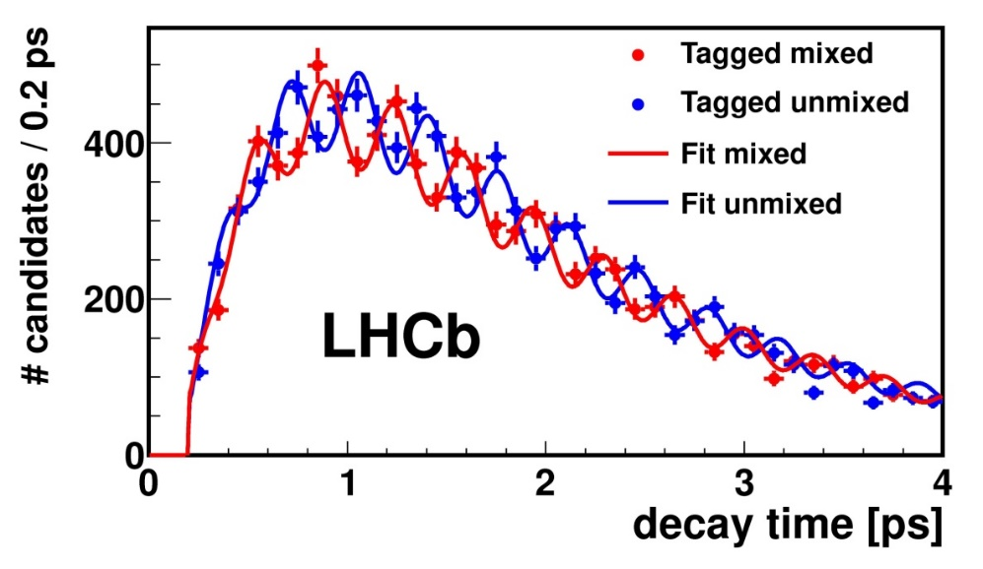
KINR at CERN
International Collaborations
LHCb (KINR since 1995 – 21 researchers)
Institute for Nuclear Research NAS Ukraine (KINR) at CERN:
LHCb
KINR contributions: Silicon Inner tracker, Beam & Background monitoring systems (RMS)
Data analysis/completed in 2024:
Cross-sections, Nuclear Modification factors- strange hadron production. Ultra Peripheral Production of charm mesons
MEDIPIX (participation)
ENLIGHT (participation)
(European Network for Light Ion Hadron Therapy)
LHCb main goal: CP violation in heavy flavor hadrons (beauty, charm) decays as one of the possible reasons for asymmetric composition of the Universe.
-

Slide 3
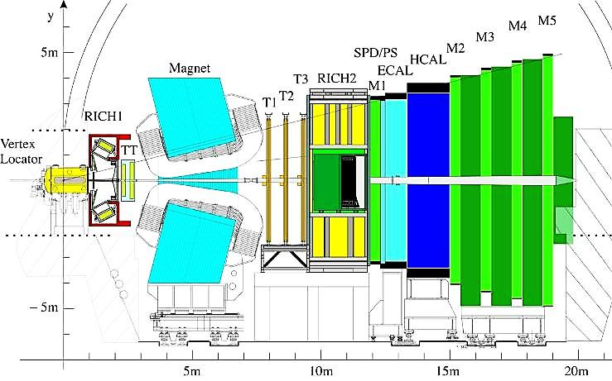
KINR at LHCb (since 1995 – 21 researchers)
Peculiarity of LHC – For the first time in the humanity history- energy available in experiments – up to 13.6 TeV !
LHCb: The Large Hadron Collider Beauty
Experiment for Precise Measurements
of CP-Violation and Rare Decays
(b-hadrons (B_{u}, B_{d} , B_{s} , B_{c} , Λ_{b} , Σ_{b} , Ξ_{b} etc.)
The LHCb detector – forward spectrometer with excellent characterisitics
Acceptance 2 < η < 5
Momentum resolution about 0.5 %
Track reconstruction efficiency > 96 %
Impact parameter resolution: ~ 20 μm
Decay time resolution: ~45 fs
b-flight length O(cm) well defined by production vertex
Invariant mass resolution:
  ~(10-20) MeV/c²
Ring-Imaging Cherenkov Detectors and Muon system - particle identification
(PID efficiency > 90%)
p
p
Integrated luminosity; up to the yesr 2040: 300 fb⁻¹

Slide 4
INR NAS UKRAINE IN LHCb EXPERIMENT (CERN)
ACHIEVEMENTS AND CHALLENGES 2024
Search for phase transitions
"Hadrons->Quark-gluon plasma (QGP) ->Hadrons".
Theory predictions -> the enhancement in the strangeness yield - >evidence of a phase transition to QGP [1. 2].
Our measurements : Multi-differential cross sections for strange Ks-mesons and Λ-baryons in collisions of protons and lead nuclei at an energy of 5. TeV.
The results (events over transverse momentum, rapidity, multiplicity) demonstrate non-trivial behavior.
CONCLUSION: Theoretical predictions on strange hadrons enhancement, as evidence of a phase transition to the QGP, are not consistent with multidimensional experimental results (next slides).

Slide 5
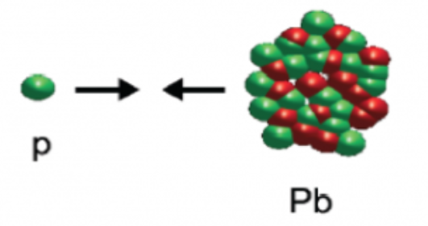
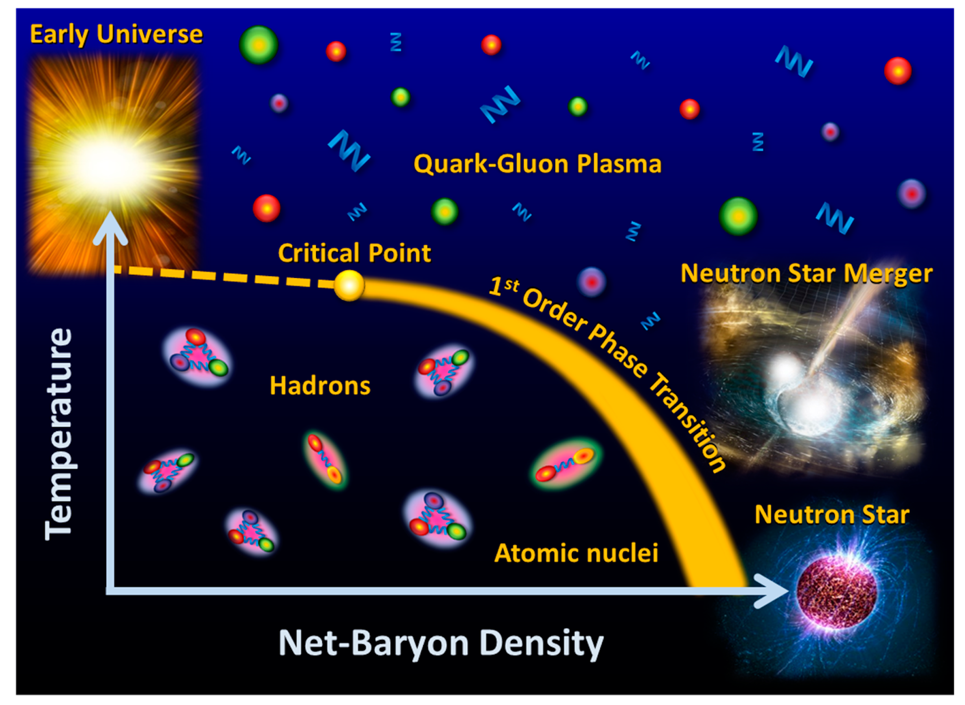
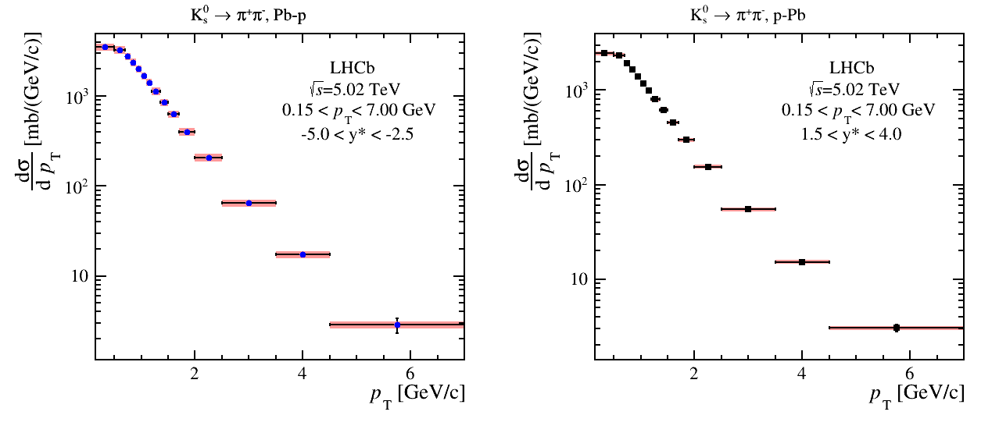
V⁰ - neutral mesons, baryons –anfi-baryons production in p-Pb collisions at 5 and 8 TeV (preliminary).
KINR at LHCb. Current activity (2024) Physics Data Analysis
LHCb Motivation: Study QCD Phase diagram –
“cold nuclear matter effects” on the way to establish a tool for observation of quark-gluon phase effects.

Slide 6
Our measurements : Multi-differential cross sections for strange Ks-mesons and Λ-baryons in collisions of protons and lead nuclei at an energy of 5. TeV.
Double differential V0 production cross sections in pPb/Pb-p collisions
Hydrodynamics-Coalescence-Jet
Fragmentation hybrid model
arXiv:1911.00826v4 [nucl-th] 21 Sep 2020]

Slide 7
Our measurements :
Multi-differential cross sections for strangeness production
Proton-lead and proton-proton collisions at 5.02 TeV.
NMF values differ from the unity – non-uniform in p_{T} spectra
Theoretical predictions on strange hadrons enhancement, as evidence of a phase transition to the QGP, are not consistent with mult-dimensional experimental results.
The data are very rich on charactristic features (level of suppression, point for R=1, position of maximum enhancement, saturation) to be met by adequate theory.

Slide 8
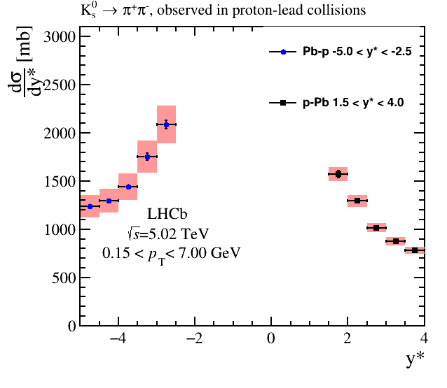
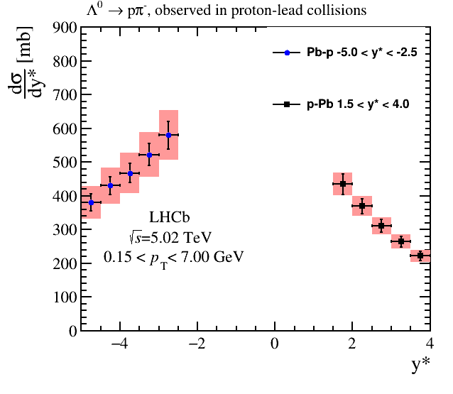
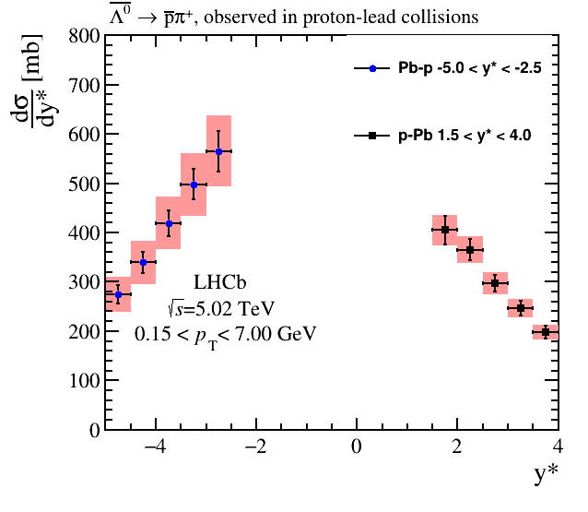
V⁰ - K_{s} mesons, Λ -, anti- Λ baryons production in p-Pb collisions at 5 and 8 TeV (preliminary).
KINR at LHCb. Current activity (2024)
Physics Data Analysis
Preliminary
Preliminary
Preliminary
LHCb Motivation: Study QCD Phase diagram –
“cold nuclear matter effects” on the way to establish a tool for observation of quark-gluon phase effects.

Slide 9
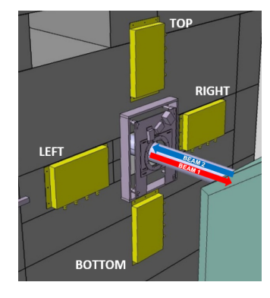
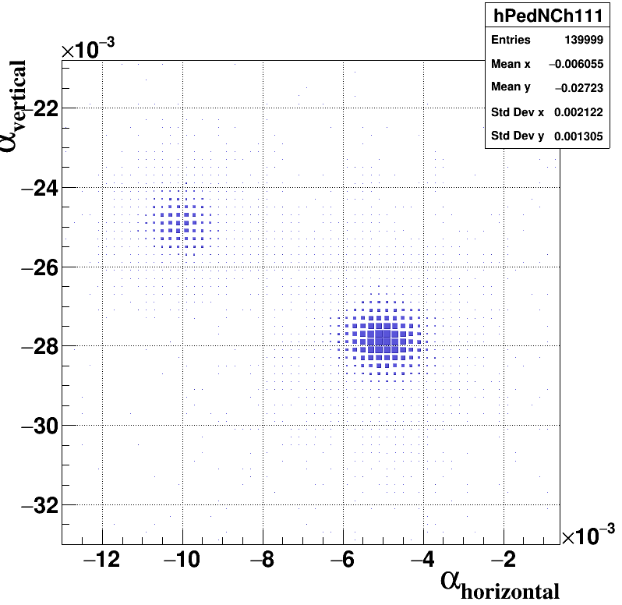
KINR at LHCb. Current activity (2024)
Upgrade of Experimental Setup for RUN3
A significant contribution to the implementation of control of safe and effective experimental conditions was made by the KINR in 2024.
To meet an increase of the instantaneous luminosity in RUN3 the new Beam and Backgound Monitoring System (RMS-R3) has been built and installed at the 2.2 m from Interaction point LHCb (IP8).
The RMS-R3, (RUN3 – 2022-2026) has demonstrated perfect functional characteristics (accuracy of about 0.1 % !), providing a control of safe and effective reproducibility of the data taking conditions.
In 2024: implemented software packages provide at the LHCb Control Room important information on running conditions, in real time.
RMS-R3 – 8 MFD detectors (4 vertical, 4 horizontal) – measure luminosity and produce a 2D-image of the nuclear interactions region (IP8-LHCb) by the method of their response asymmetries (right panel).
For the significant contribution in the safe and efficient operation of the LHCb experiment, Sergey Chernyshenko is nominated for the LHCb Prize for young scientists.

Slide 10
KINR at LHCb. FUTURE activity (2027-2040)
Experimental Setup (Upgrade II )
LHCb will be operated at instantaneous luminosity increased by two orders of magnitude compared to RUN1 in the new series of physical measurements in the HL-LHC era (2030-2040) .
KINR Scientists participate in the LHCb UPGRADE II Program, developing a new monitoring system (RMS-R4).
Scientists from the KINR, as members of the LHCb Collaboration were awarded “Breakthrough Prize in Fundamental Physics” in the year 2025.

Slide 11
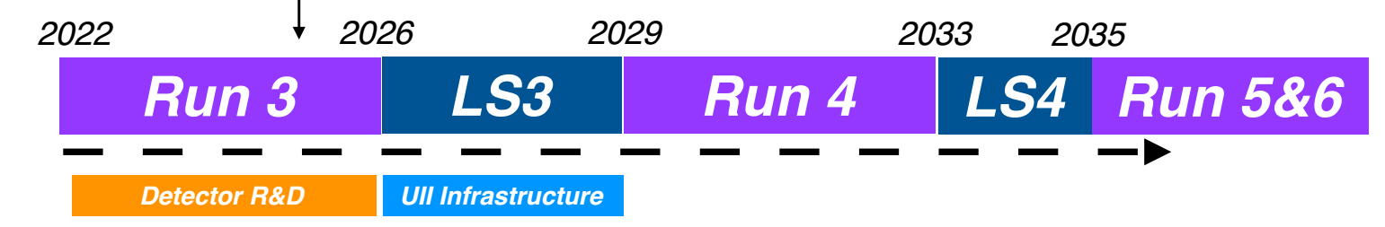
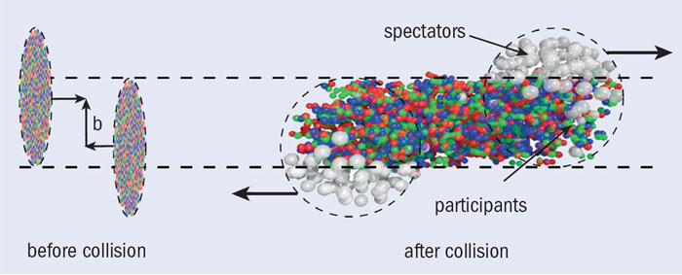
FUTURE of KINR at the LHCb (CERN)
Contribution to European Strategy in Particle Physics (ESPP)
Workshop HEP -TEC-2025
included ESPP issues from the KINR side.
Physics.
CP – violation, as the way to NEW Physics
K₀^{S} , Λ , - QCD Phase diagramm peculiarities
Charged hadrons modification factors, impact of final state multiplicities: colliding and fixed target modes (EURIZON FP and EIRENE (MPG) projects.
4. Physics and Techniques of the triple nuclear collisions – new horizons.
Events with three nuclei interaction !
  Intriguing opportunity with metal microstrip target – never explored in earlier experiments !
  Might be very interesting phenomenon:
  What will be the Equation of State ?
  Which temperatures and densities
  of the hot matter part might be ?

Slide 12
Brief Summary on Achievements and Challenges in the LHCb 2024
Our studies revealed several mechanisms of strange hadron production : Thermodynamics, Hydrodynamics, Coalescence, Jet Fragmentation hybrid model. The original results on the ultra-peripheral production of charmonium in Pb-Pb collisions at an energy of 5 TeV.
The "toolbox" for the selection of theoretical models is enriched by experimental data comparing the dependences of the differential cross sections of strange hadron production in proton-proton and proton-nuclear collisions.
We have established several powerful criteria for the selection of the theoretical models using nuclear modification factors, as well as the ratios of the cross sections of the production of mesons to baryons, baryons to anti-baryons and opposite rapidity.
Nuclear modification factors demonstrate a clear dependence on the multiplicity of final states of the studied processes.
Challenges solution: Detailed analysis of challenging data at higher collision energy of 8.16 TeV, with a statistical accuracy two orders of magnitude higher than that at 5.02 TeV.

Slide 13
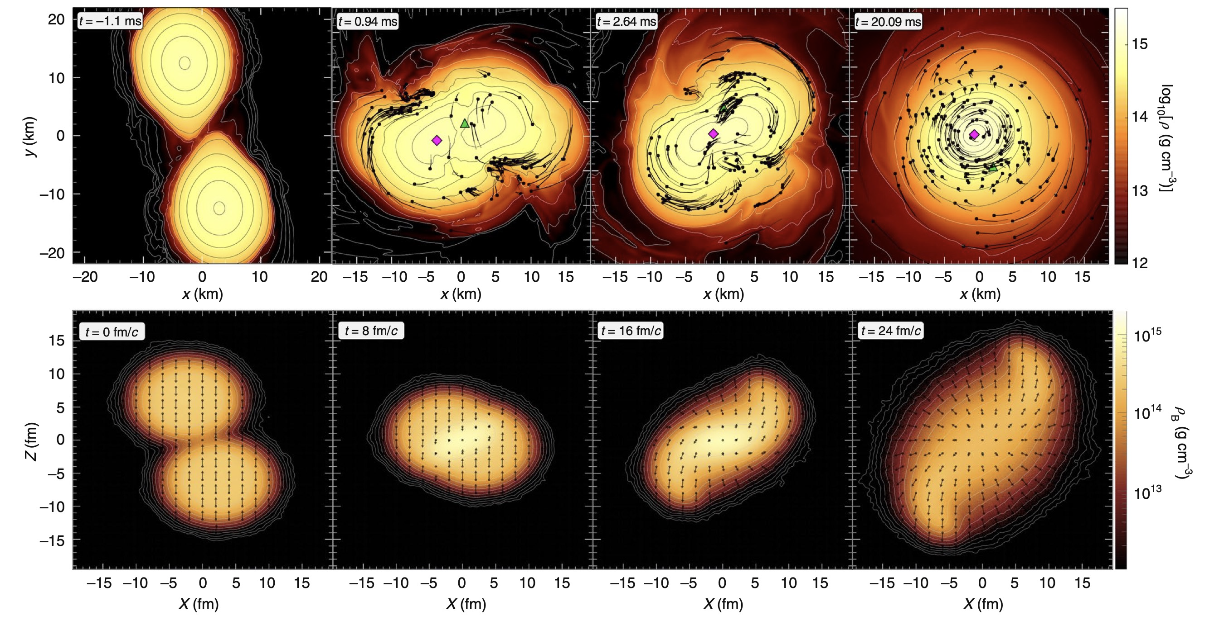
2. Building new experiment at GSI/FAIR (the year 2024).
CBM – Compressed Caryonic Matter.
Future experiment CBM (Compressed Baryonic Matter) goal:
To study the phase diagram of QCD in the region of high baryon densities (n-stars).
Extreme conditions will be provided with the SIS100 accelerator at collision energies of heavy nuclei 2 -10 GeV/nucleon.
Nuclear interaction frequencies 0.1 - 1 MHz (2028), 10 MHz (2030 -2032), 100 MHz ( 2035-2040). High radiation loads
- the need for a wide dynamic range system for continuous monitoring of experimental conditions.
(More details in presentation by Dmytro Ramazanov at this conference)
Compression of matter (simulations):
in the merger of neutron stars (top)
In the collisions of nuclei (bottom)

Slide 14
Building the CBM experiment at GSI/FAIR
(Year 2024).
The first series of physical measurements (RUN1) 2028 - 2032. 0.1 <IR < 10 MHz. GOAL -properties of matter with a density few times higher than the nucleus one, expected in neutron stars. KINR contribution – STS (5 PhD theses, more to come !).
We have proposed an upgrade of the silicon tracking system, STS (RUN2, 2035 – 2039, to perform physical measurements at collision frequencies up to 100 МHц- to improve statistics.
Upgrade: combination of MAPS and double-sided microstrip detectors. Simulations: ( Ltspice, Geant4, Allpix2) - to reproduces the full chain of events in the operation of the detector module (more details- Oleksandr Kshyvanskyi report at this conference).

Slide 15
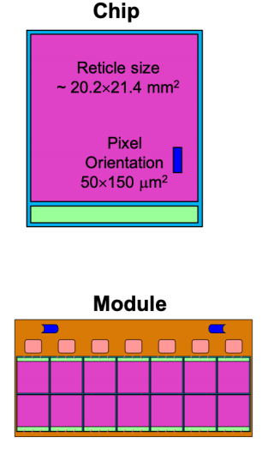
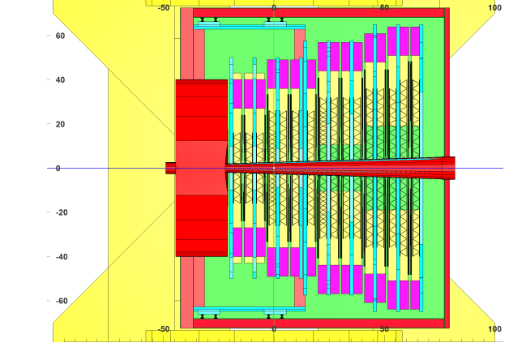
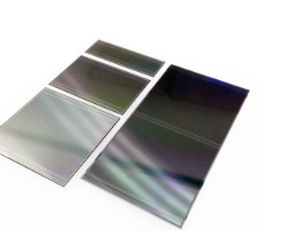
CBM STS Proposed Upgrade (RUN2, 2035 – 2039) - Combined MAPS and Double sided microstrip detectors.
To perform physical measurements at collision frequencies up to 100 МHц- to improve statistics -> need monitoringof radiation loads !
Two options were considered:
a) application of the RMS-R3 system after the completion of the RUN3 at LHCb (CERN) in 2026;
b) Building a a completely new system with the Utopia 2 (CERN) readout chip (9 orders of magnitude dynamic range)
.
In 2024, evaluations illustrate the sustainability of the MS-R1-CBM for measuring Interaction rate and mapping the interaction area using the method of asymmetry of the response of its sensors.
The design for the CBM STS (3 + 5) Upgrade: (MAPS & Double-sided Microstrip Silion detectors):
  the first three stations (1, 2, 3) -> MAPS
  the stations 4 – 8 ->
    MAPS in areas close to the beam axis (2.5 < θ <12.5 deg, )
    (More details: Presentation by M. Pugach at this conference)

Slide 16
SUMMARY & OUTLOOK
KINR Team in 2024 contributed successfully to the LHCb and CBM experiments.
Important results were obtained in LHCb data analysis revealing the challenge for the development of theoretical models capaable to describe multi-differential cross-sections of strange hadrons production rather than predict their global yields.
Great achievement has been reached by implementing software packages for controlling RMS-R3 data on the Beam and Background conditions in the LHCb experiment.
The challenging task of monitoring system at extremely high LHC luminosity is close to be solved by building RMS-R4 prototype.
Constructive contributions are made to the future experiment CBM by participation in the STS construction (tests, codes simulating STS detector modules performance), development of the STS Upgrade project and building the prototype of Beam and Background conditions monitoring system.
!

Slide 17
ACKNOWLEDGEMENTS
This work received financial support within the Grant EU #3014 Fellowships programme of EURIZON. Grant № 871072 as well as within the IP2 period of time in frames of the Working Package WP7 – DETEC . EURIZON. Grant № 871072.
We appreciate the financial support in frames of the budget theme of the National Academy of Sciences of Ukraine.
THANK YOU FOR YOUR ATTENTION !

Slide 18
Backup slides

Slide 19
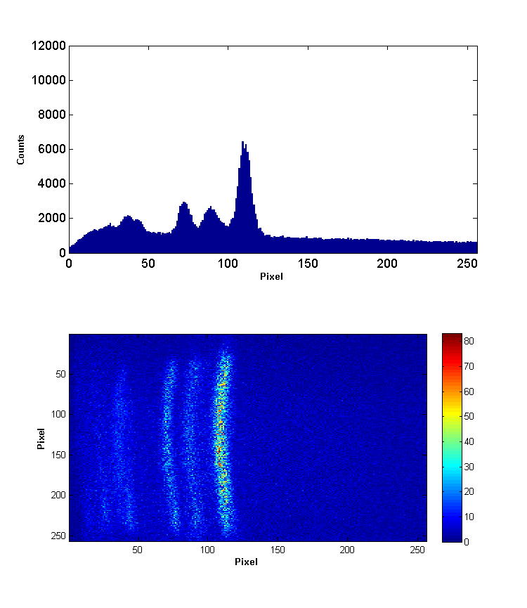
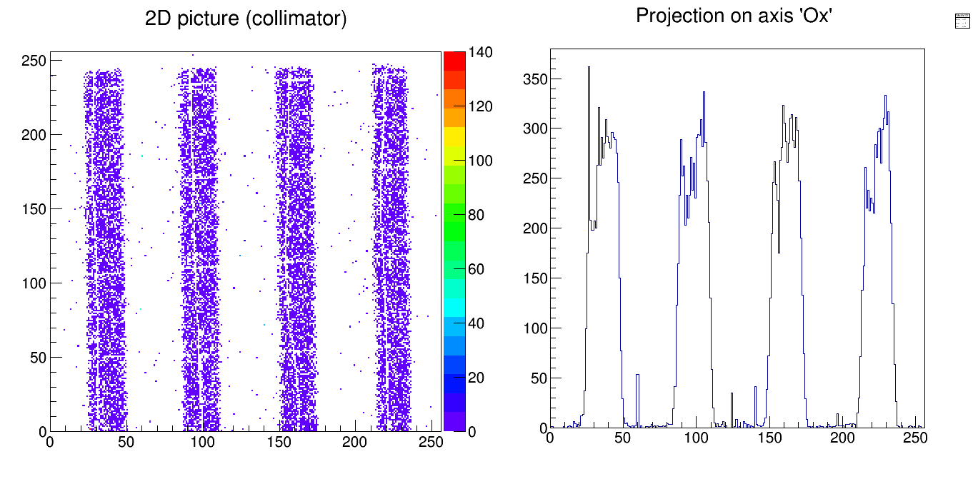
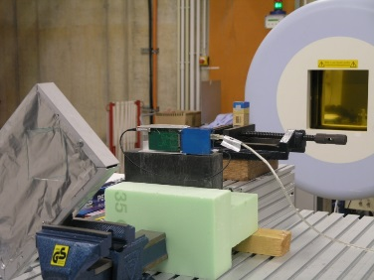
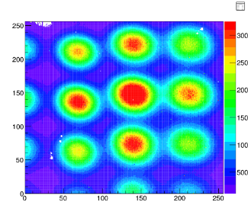
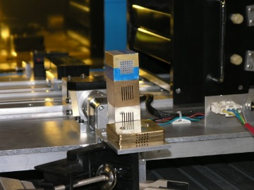
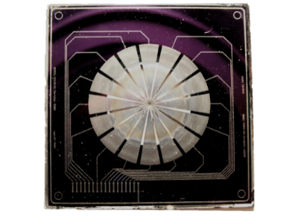
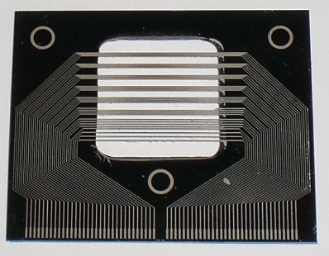
From particle physics to medicine, Material Science, nuclear physics, etc.
X-ray difractometer (IPM NAS Ukraine. Kyiv
Laser mass-spectrometer at IAP NAS Ukraine (Sumy)
HIT (Heidelberg Ion Therapy Center)
ESRF (Grenoble) – X-rays mini-, micro-beams
KINR Tandem generator – “aneutronic fusion” ¹¹B (p, 3α)
Metal and hybrid TimePix detectors imaging beams of particles

Slide 20
International Collaboration MEDIPIX, ENLIGHT
(KINR –observer participation since 2007)
MEDIPIX detectors implemented by KINR researches :
for studies in material science as an electronic focal plane:
Laser mass-spectrometer at IAP NAS Ukraine (Sumy)
X-ray difractometer (IPM NAS Ukraine. Kyiv)
For the purposes of spatially fractionated radiotherapy:
ESRF (Grenoble) – X-rays mini-, micro-beams
HIT (Heidelberg Ion Therapy Center)
For correlative studies of low energy nuclear reactions (KINR Tandem generator – “aneutronic fusion” ¹¹B (p, 3α)
Metal and hybrid TimePix detectors imaging beams of particles

Slide 21

Н А К А З
«29» квітня 2025 р.
За видатні наукові досягнення в дослідженнях асиметрії матерії та анти-матерії,
-відкриття нових сильно взаємодіючих частинок,
-спостереження рідкісних процесів
-дослідження природи на найкоротших відстанях та в найекстремальніших умовах на Великому адронному колайдері в ЦЕРН у складі міжнародної колаборації LHCb, які відзначені однією з найпрестижніших нагород у світі науки — Breakthrough Prize in Fundamental Physics (у 2025 році) https://breakthroughprize.org/Laureates/1/L3995
Оголосити подяку співробітникам відділу фізики високих енергій:
Пугачу Валерію Михайловичу, зав. відділу
Охріменку Олександру Юрійовичу, в.о. н.с.
Добішуку Василю Миколайовичу, м.н.с. (звільнився 25.10.2024 р.)
Колієву Сергію Миколайовичу, м.н.с.
Коту Олександру Андрійовичу, в.о. пр. інж.
Лукашенко Валерії Євгеніївні, в.о. пр. інж.
Чернишенку Сергію Борисовичу, в.о. м.н.с
Малигіній Ганні Михайлівні, (звільнилась 12.10.2021 р.)
Костюку Ігорю Олександровичу, (звільнився 31.12.2017 р.)
Кшиванському Олександру Олександровичу, аспірант 3-ого року навч.
Т.в.о. директора Володимир ДАВИДОВСЬКИЙ
Breakthrough Prize. Статтю про це можна прочитати у «Дзеркалі тижня»: https://zn.ua/ukr/EDUCATION/ukrajinski-naukovtsi-sred-
laureativ-naukovoho-oskara-breakthrough-prize.html

