Slide 1





BEAM AND BACKGROUND MONITORING SYSTEM
FOR THE CBM EXPERIMENT AT FAIR/GSI.
V.M. Pugatch, A.V. Chaus, S.B. Chernyshenko, O.S. Kovalchuk,
O.O. Kshyvanskyi, V.O. Kyva, M.V. Pugach, D.M.Ramazanov
Institute for Nuclear Research. National Academy of Sciences of Ukraine, Kyiv
Scientific Conference KINR-2025
26 – 30 May 2025. Kyiv

Slide 2
The CBM (Compressed Baryonic Matter) experiment at GSI/FAIR (Darmstadt)
Start data taking in 2028.
The main goal - to study QCD phase diagram in the region of high baryon densities.
Extreme conditions at the accelerator complex SIS100 (FAIR) at 2 -10 GeV/nucleon.
High rates nuclear interactions: 0.1 - 1 MHz (2028), 10 MHz (2030 -2032), 100 MHz. (after MAPS modernization 2035-2040).
High radiation loads - need monitoring to provide safe and effective conditions.
Phase diagram of quantum chromodynamics:
Temperature – Baryon chemical potential .

Slide 3
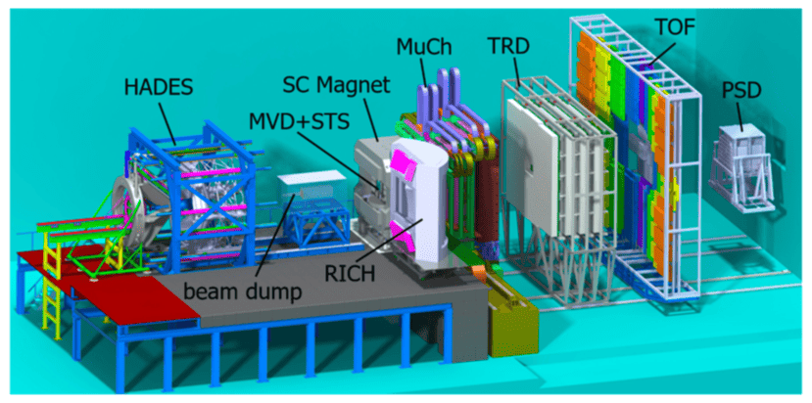
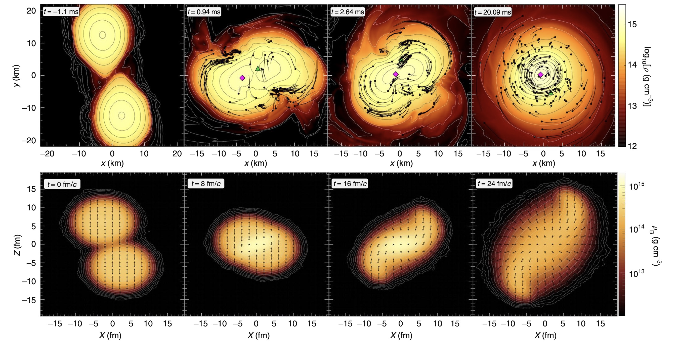
CBM DETECTOR
RUN1: 2028 – 2032. 0.1 <IR < 10 MHz
PURPOSE:
Study QCD Phase Diagram
Measure multi- differential hadron production cross-sections
CBM Detector:
Muon and electron configurations
Compression of the Matter (simulations):
Neutron star merger (top)
Au nuclei collisions (bottom)

Slide 4
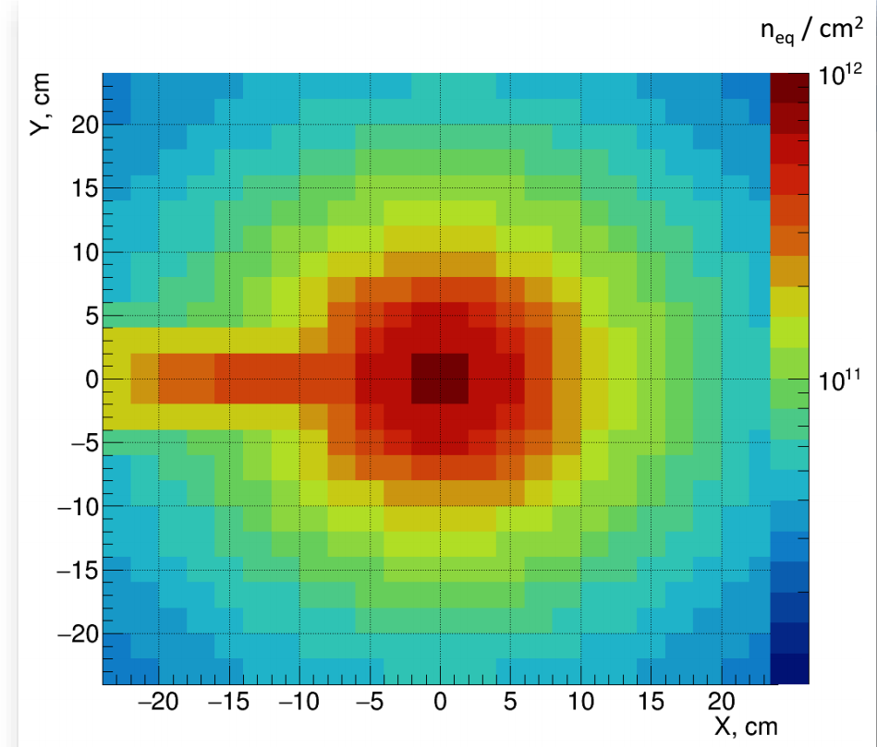
“FLUKA”- simulations for the spatial distribution of radiation load .
Distribution of radiation load at the first STS station
(Courtesy Anna Senger)
One needsto monitor radiation load !

Slide 5
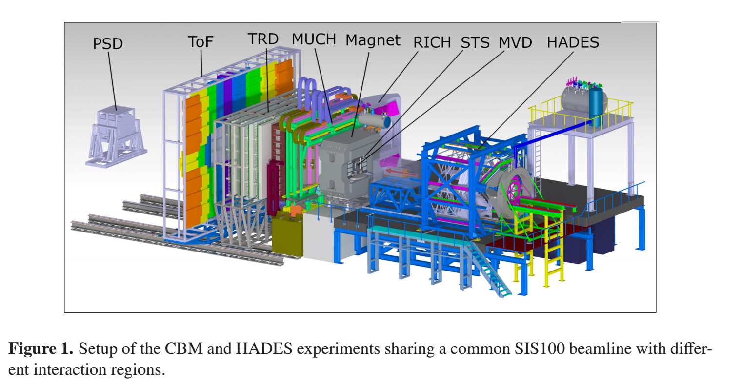
Design of a Monitoring System MS-R1 for experimental conditions and safety of the CBM Experiment
PURPOSE:
Monitoring the conditions and safety of the experiment, important for the effective use
of the valuable SIS100 time.
Realization:
MS-R1-СВМ- Metal Foil Detectors Technology developed at KINR
Two options:
RMS-R3 (LHCb) after RUN3 data taking (2026)
2. New system

Slide 6
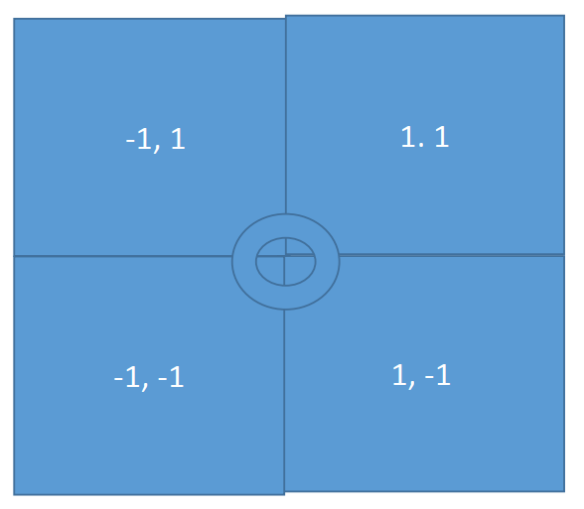
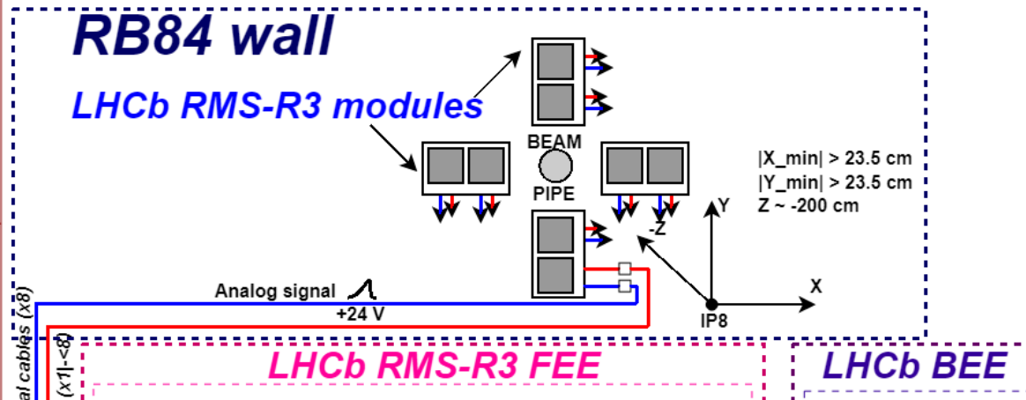
Asymmetry method of paired sdetectors MS-R1-CBM for nuclear interaction region monitoring.
Asymmetry of paired detectors response:
А_{ij} = (R_{i} – R_{j} ) / (R_{i} + R_{j} ),
Ri та Rj – detectors response i and j (LEFT - RIGHT or UP – DOWN)
The magnitude of asymmetry А_{ij} does not depend on the frequency of nuclear interactions!
Possible localization of events :
2D asymmetries (from -1 to + 1 on both axes)
The amplitude of the detector response depends on:the cross-section ( d²σ /dθ dϕ )
the polar (θ), azimuthal (ϕ) and solid angles (dΩ) of the detectors,
the instantaneous luminosity and parameters of the beams and the target

Slide 7
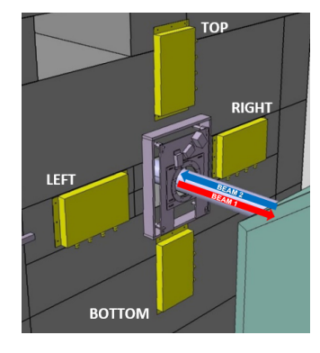
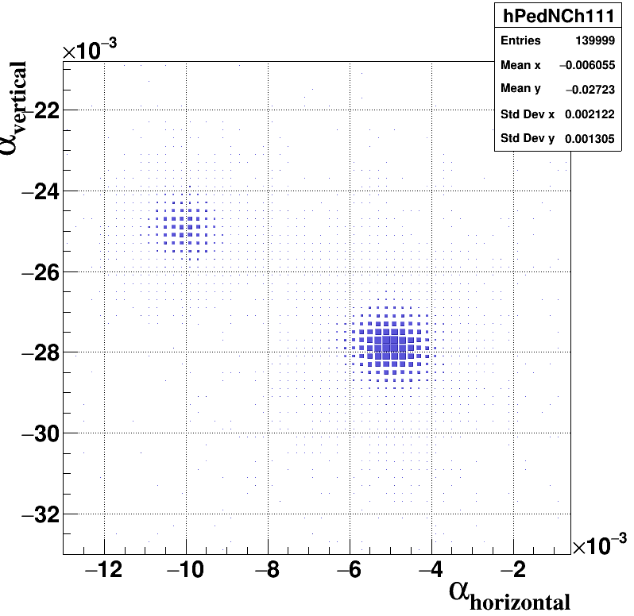
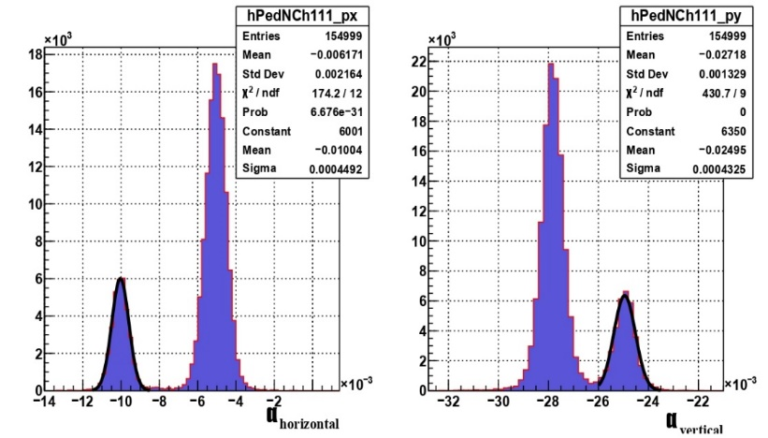
1. RMS-R3 (LHCb) in СВМ.
Measurement of IR and position of the interaction region
LHCb RMS-R3: Instantaneous luminosity 2*10³³ cm⁻² s⁻¹. Localization of the interaction region
CBM
RMS-R3 transported from CERN to GSI (Darmstadt) in the year 2027. After mounting it on specific supporting frames it might be installed in the CBM experimental setup at the edge of the dipole magnet in close vicinity to the Silicon Tracking System.
CBM Instantaneous luminosity 2*10³¹cm⁻² s^{-1 and}
Localization of the interaction region
,Asymmetry method to observe halo touches the target frame . OR another source of background out of the target.
RMS-R3 в LHCb. Demonstrated sensitivity to changes of the experiement conditions

Slide 8
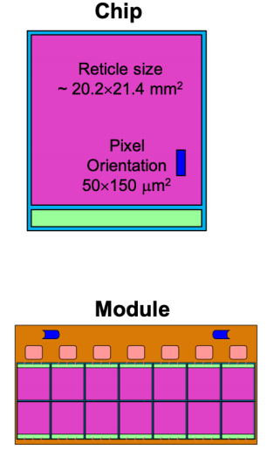
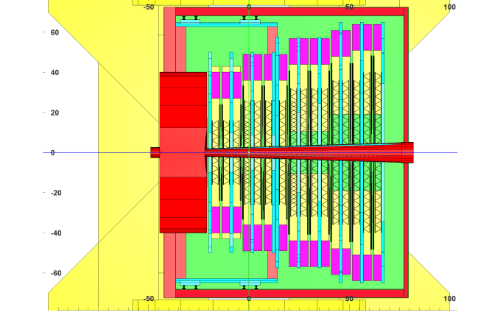
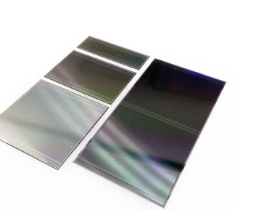
CBM STS Proposed Upgrade (RUN2, 2035 – 2039, IR -> 100 MHz).
Combined MAPS and Double sided microstrip detectors.
Down scoping approach:
STS stations construction -> MAPS and original microstrip detectors:
  the first three stations (1, 2, 3) -> MAPS
  the rest five stations (4 – 8) ->
    MAPS in areas close to the beam axis (2.5 < θ <12.5 deg, )
    Micro strip detectors-> in their original position for 12.5 < θ <25 deg,
The design for the CBM STS (3 + 5) Upgrade (MAPS & Double-sided Microstrip Silicon detectors):
Number of MightyPix chips is lower, three times lower power consumption (2.5 kW). Relevant costs for MAPS drop from ~ 2.5 MEUR to 0.8 MEUR
Micro strip detectors require power of ~ 15 kW station (from the 4th to the 8th ) and cooling to dissipate the heat.

Slide 9
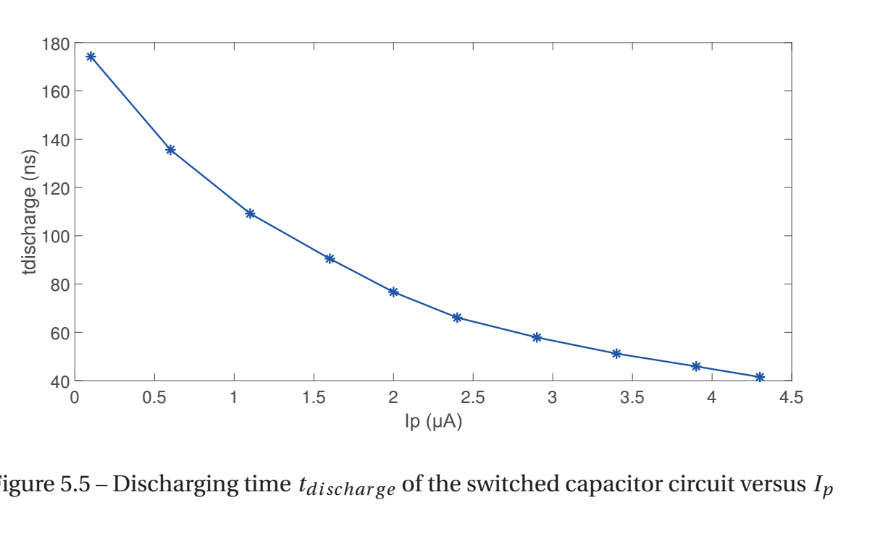
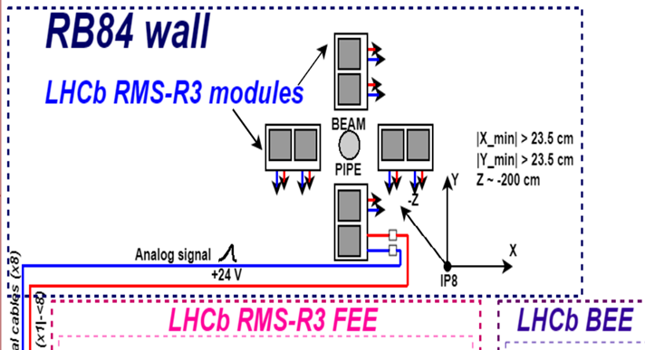
Option 2. New system - СВМ -MS-R1.
Measurement of IR and position of the nuclei interaction
8 detector modules configured as in the LHCb RMS-R3.
The readout is completely new.
The readout chip is "A Nine Decade Femtoampere Curren to Frequency Converter" - Utopia 2.
The Utopia 2 ASIC measures input currents from 2 fA over a wide dynamic range (9 orders of magnitude).
By implementing a multi-band ASIC architecture, it can digitize currents down to 5 μA.
* Request sent to CERN

Slide 10
Mounting Structure for Monitoring System MS-R1- СВМ
For installation of the MS-R1 system in the detector environment of the CBM experiment, it is planned to use two rectangular frames. (the outer one for fixing the system as a whole, the inner one for supporting the detector modules of the system).
The frames are folded at the sight of L-like metal rails with visible threads to attach the elements of the system, being installed in the working position behind the housing of the dipole magnet –last station of the STS .
Inner rail (Carbon Fiber) - width 1 cm, thickness - 0.5 cm) The thickness of sensitive balls of detector modules is 0.25 mm. The thickness of the structure of the modules in the bundle is 16 mm.(more details- Dmytro Ramazanov’s presentation)

Slide 11
SUMMARY
The main tasks of the monitoring system are defined to control the stability and reproduction of the experimental conditions, including mapping the interaction area using the asymmetry of the response of its sensors.
The design (two options) and expected functional characteristics of the system for monitoring the conditions and safety of the future CBM experiment (GSI/FAIR) was worked out.
The evaluations performed illustrate the capability of MS-CBM-R1 system (based on the physics and techniques of metal foil detectors) to operate in a wide range of nuclear interaction rates from 0.1 to 100 MHz.

Slide 12
ACKNOWLEDGEMENTS
These studies were partially funded under the project of the Institute ofor Nuclear Research of the NAS of Ukraine "Physical and technical foundations of the study of the properties of strange hadrons in the CBM experiment (FAIR / GSI)". within the framework of the Targeted Scientific Program of the NAS of Ukraine "Fundamental Research in High Energy Physics and Nuclear Physics (International Cooperation)".
The studies were performed under the financial support within the EU Grant Agreement № 871072. EURIZON (IP1, IP2) as well as its Fellowships Program Grant EU #3014 “RMS beam and background online monitoring system in the LHCb experimental environment”.
ДЯКУЮ ЗА УВАГУ !

