Slide 1



¹ Tmepix-3 – an Instrument for NEW ART –Real Time Electronic Painting Valery Pugatch Institute for Nuclear Research NAS Ukraine HEP-TEC-2026 KYIV. !4-15 January 2026

Slide 2
INTRODUCTION
NEW ART.
LIVE ELECTRONIC PAINTING -MUSIC OF COLORS
GIFT (VIRTUAL ?) TO MICHAEL CAMPBELL
(Former Spoksperson of MEDIPIX Collaborations at CERN)

Slide 3

Our invention: LIVE Electronic Painting of various beauties of Nature.
Unusual application of Timepix
,The New Art – LIVE Electronic Painting
– Music of Colors.
It will be A new area of human creativity.
A tool and its functioning are considered for creating individual compositions of a new art.
Traditional artists to depict , for instance, a landscape (fixed in time), use special mixtures of paints, which they apply with brushes to the canvases of future painting.
One can use lasers with tunable frequency as electronic sources of wide range colors, varying in real time.
The created paintings will be imaged by means of electronic devices (Timepix display, for instance).
The brightness of a certain color, its duration, accompaniment by other colors, etc., will depend on the emotions of the composer, his inspiration and the originality of the feeling of the essence of the performed composition !

Slide 4
The color palette will be provided by a big number of frequencymodulated lasers as sources of a wide ranghe o visible light. In fact, this will be an electronic painting of landscape or sea with a dynamic evolution of the picture in real time.
LIVE ELECTRONIC PAINTING -MUSIC OF COLORS –EYES !
(Music of sounds – EARS)

Slide 5
LIVE Electronic Painting of various beauties of Nature.
Unusual application of Timepix
The generation mode will be set by the software code with the possibility of its on-line modification to reflect the emotions of the performer.
For instance, in the Music of Sounds, the powerful instrument is an Organ. In the Music of Colors, the ColorOrgan does not exist, yet…
Its first prototype of COLORGAN could be built using a matrix of 14 x 14 lasers (a diameter of about 1 mm) viewed by 256 x 256 pixels Timepix.
The picture created by the artist will be reproduced by means of a perfect device (like Timepix3) on its display or external screen.
The corresponding Color Music notes have to be developed to enable the composition to be reproduced even after hundreds of years passed !

Slide 6
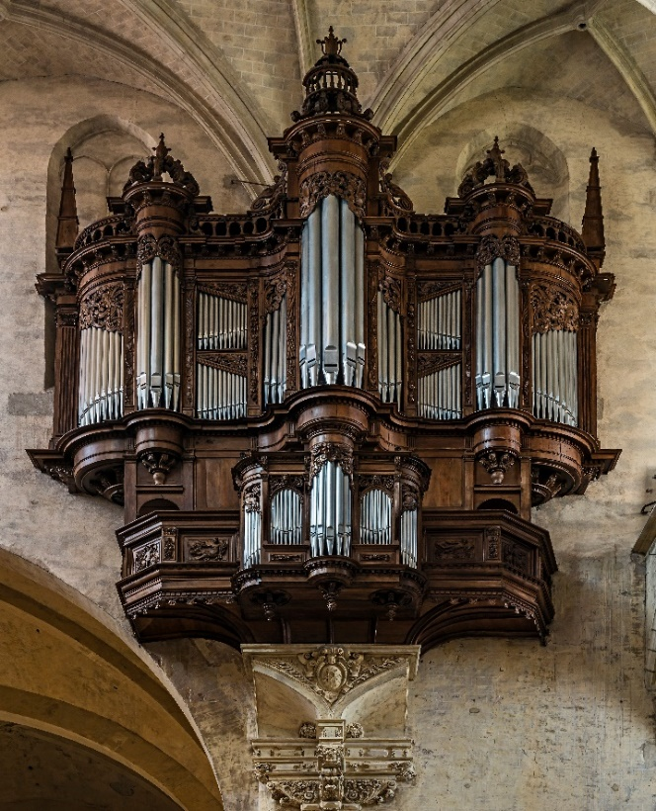
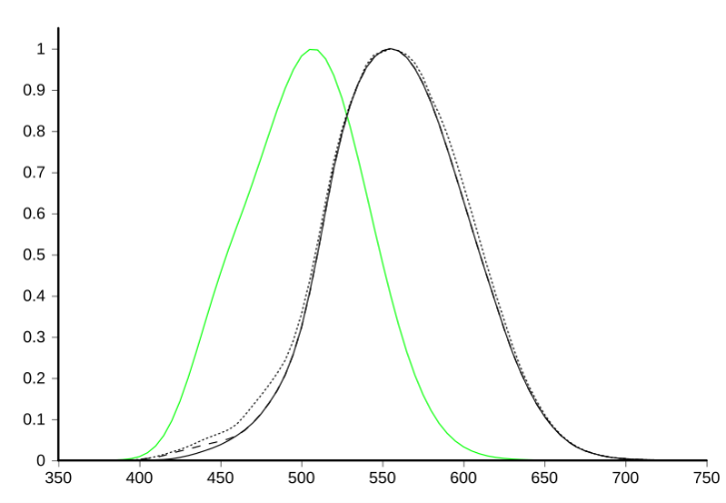
Compare Sounds Music and Color Music Unusual application of Timepix. LIVE Electronic Painting
MUSIC OF SOUNDS-ORGAN
MUSIC OF Colors-ORGAN
. 10 Hz – 30 kHz
It has forty-seven stops
on four manual keyboards,
and a set of foot pedals.
https://en.wikipedia.org/
wiki/Toulouse_Cathedral#Organs
COLORORGAN still to be created … It will have NNN stops
on fXXX manual keyboards,
and a set of foot pedals.
1451–1475

Slide 7
Summary and Outlook
LIVE Electronic Painting -The Music of Colors
is awaiting for composers and inspired performers!
There is a big room for discoveries by scientists and engineers
to make it a reality !

Slide 8
Acknowledgements
Many Thanks,
Dear MICHAEL for creating TIMEPIX Devices !

Slide 9
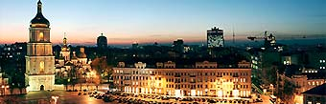
Thank you for your attention!
Welcome to Kyiv !

